Slide 1


A review of diffraction at HERA
Janusz Malka (DESY)
on behalf of H1 and ZEUS Collaborations
XXII. International Workshop on Deep-Inelastic Scattering and Related Subjects
Warsaw, 29/04/2014

Slide 2
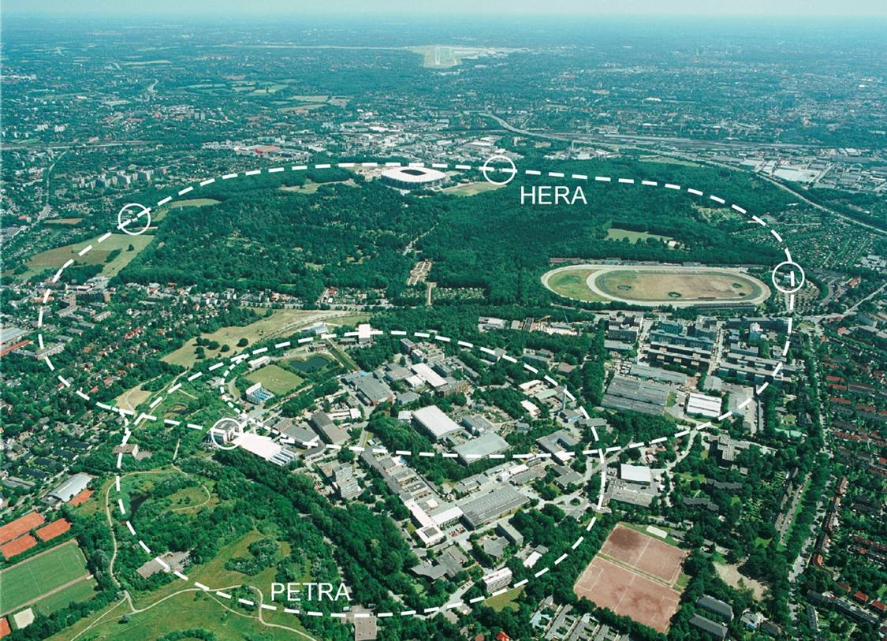
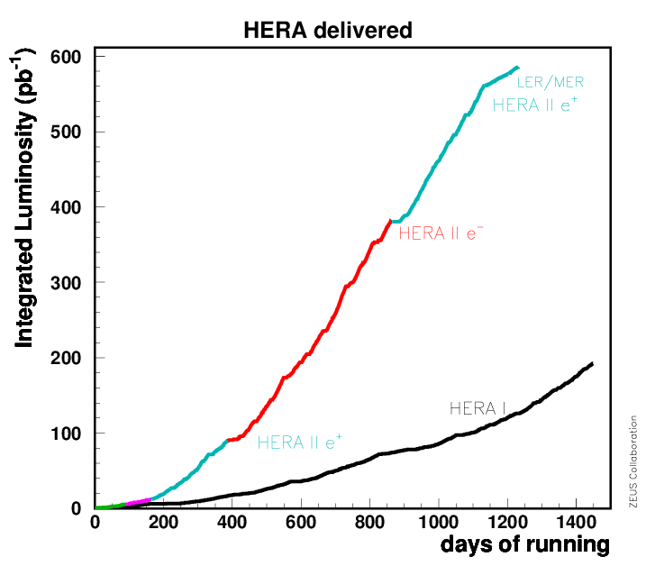
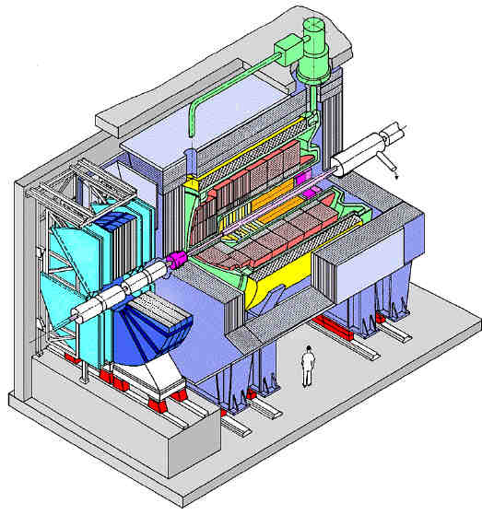
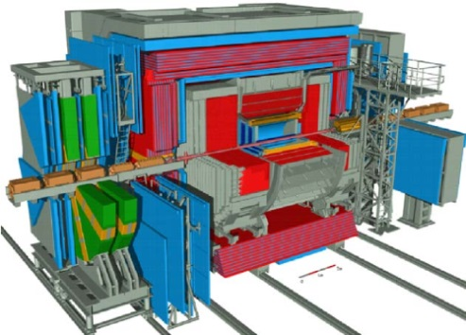
HERA ep collider (1992 – 2007)
The world’s only electron/positron-proton collider at DESY, Hamburg
E_{e} = 27.6 GeV, E_{p} = 920 GeV (820, 460, 575 GeV)
Two collider experiments: H1 and ZEUS
total luminosity ~ 0.5 fb⁻¹per experiment

Slide 3
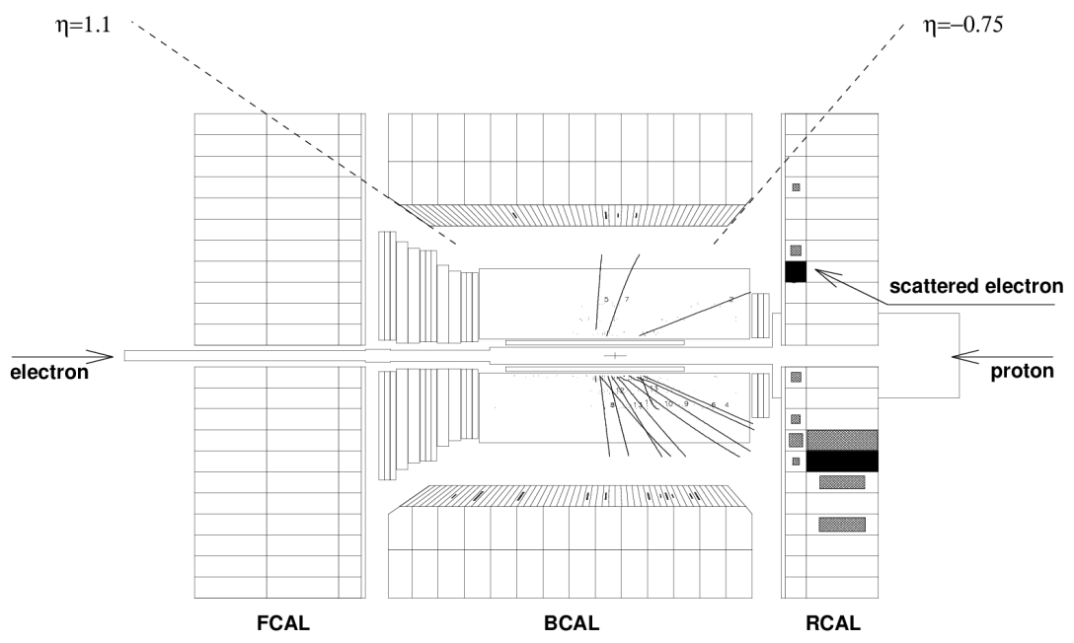
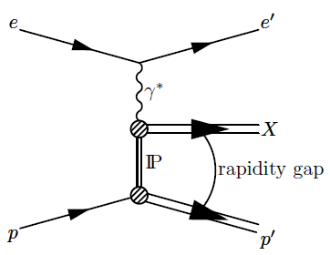
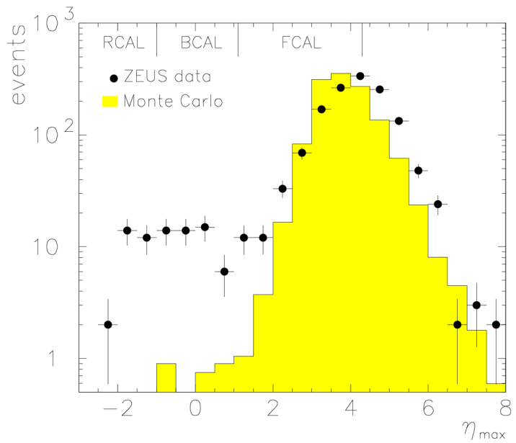
21 years of diffraction @ HERA
First observation of events with a Large Rapidity Gap in DIS at HERA
An object carrying the quantum numbers of vacuum is exchanged between γ* and p: Pomeron
Physics Letters B 315 (1993) 481-493

Slide 4
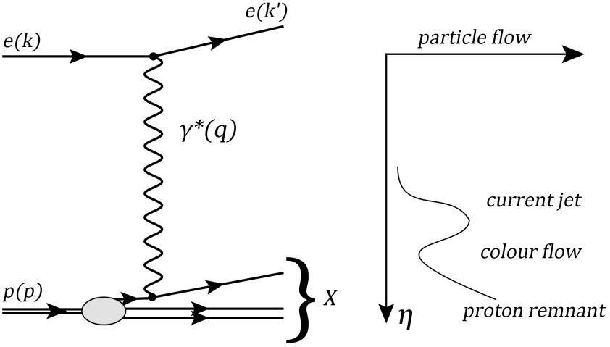
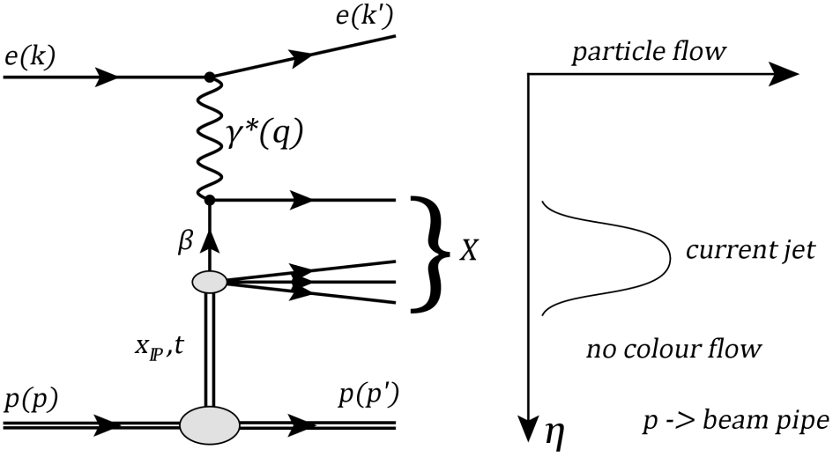
Diffractive scattering
Deep Inelastic Scattering (DIS)
Q² = -q² - virtuality of the photon
Q² ≈ 0 photoproduction, Q² > 0 DIS
W photon-proton CME
x Bjorken-x: fraction of proton’s momentum carried by struck quark
y = Pq/Pk inelasticity
Diffractive Scattering (DDIS)
x_{IP} fraction of proton’s momentum of
the colour singlet system
t = (p-p’)² 4-momentum transfer squared at proton vertex
β = x/x_{IP} fraction of IP carried by the quark “seen” by photon

Slide 5
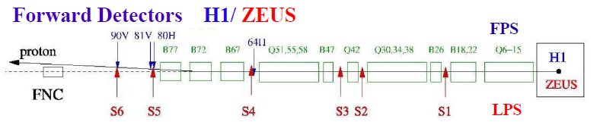
Experimental Methods
Large Rapidity Gap:
  contains proton dissociative background
  high statistics
proton spectrometer:
  clean measurement p-tagging
  no proton dissociative background
  low statistics
←
VFPS

Slide 6
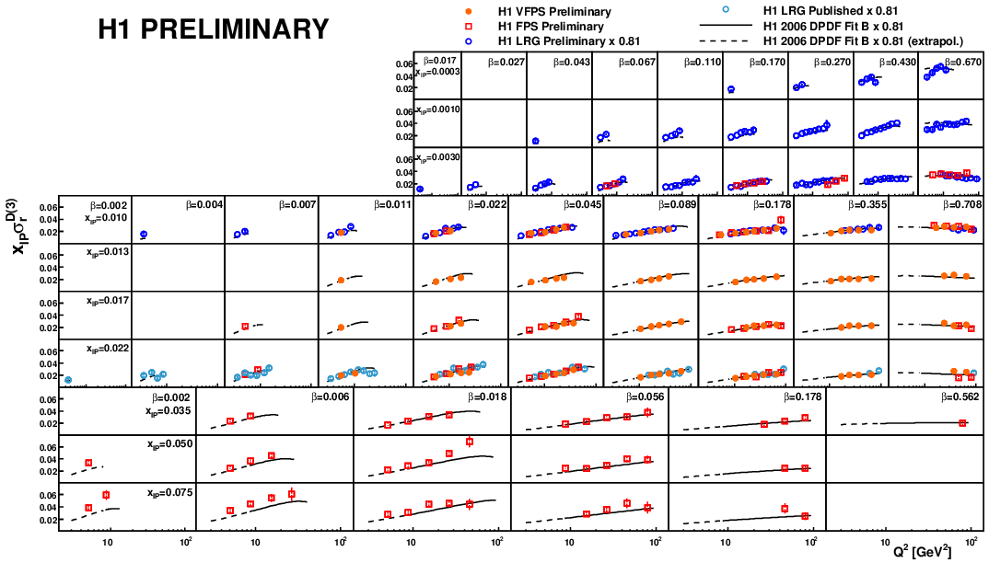
Diffractive Structure Function Measurements
Experimental summary of H1 F₂^{D} measurements
The data compare well with H1 Fit B prediction
LRG
VFPS
FPS

Slide 7

Diffractive cross section
In analogy to the inclusive DIS cross section, the inclusive diffractive cross section:
reduced diffractive cross section is:
Integrate over t when proton is not tagged → σ_{r}^{D(4)} (β,Q²,x_{IP})
σ_{r}^{D(4)} ≈ F₂^{D(4)} at low and medium y
σ_{r}^{D(4)} = F₂^{D(4)} if F_{L}^{D(4)} = 0

Slide 8
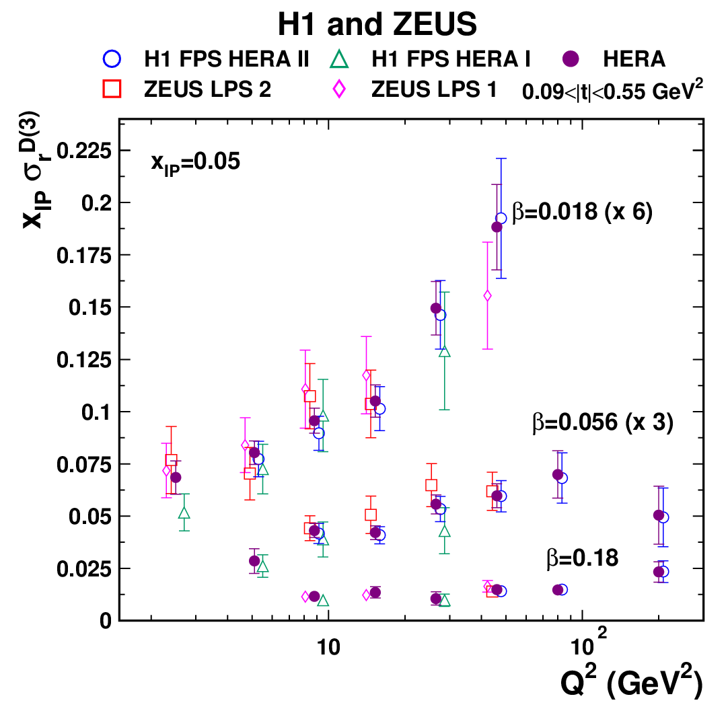
HERA combined inclusive diffractive cross sections
Proton spectrometers to detect the leading protons
First combined inclusive diffractive cross sections:
  H1: EPJ C71 (2011) 1578
  H1: EPJ C48 (2006) 749
  ZEUS: Nucl. Phys B816 (2009) 1
  ZEUS: EPJ C38 (2004) 43
The input data are consistent with χ²_{min}/ndof = 133/161
Total uncertainty on cross section is 6% for the most precise points
Eur. Phys. J. C72 (2012) 2175

Slide 9
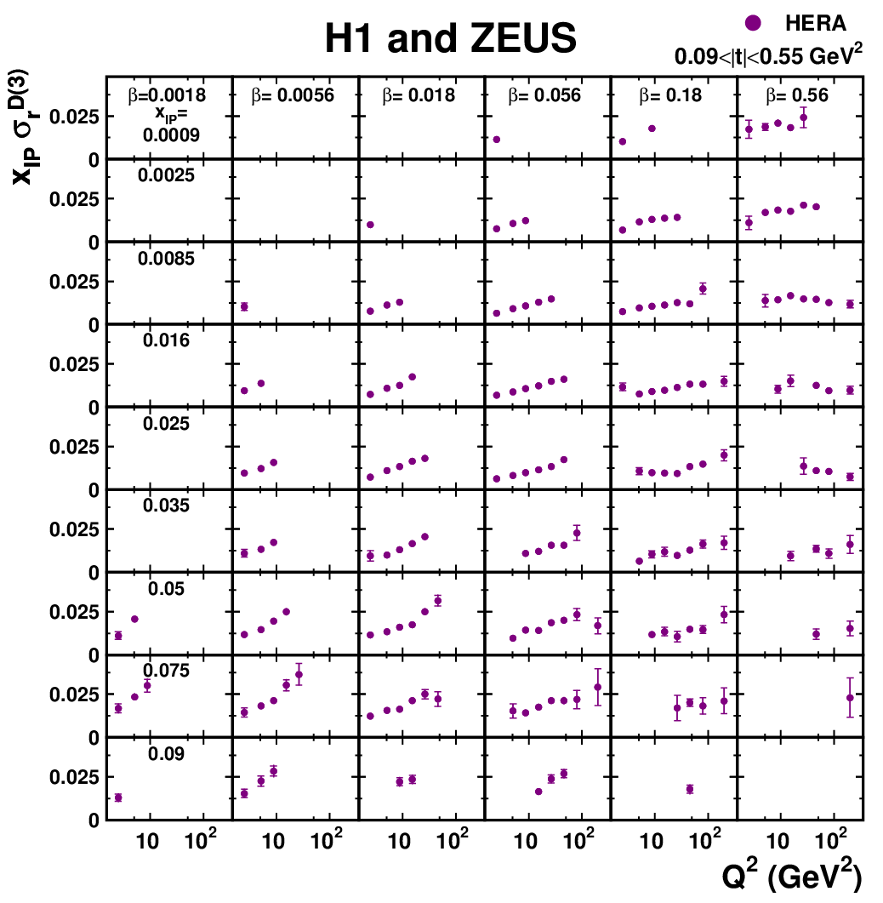
HERA combined inclusive diffractive cross sections
The combination results in more precise results and
wide kinematic range:
  2.5 ≤ Q² ≤ 200 GeV²
  0.0018 ≤ β ≤ 0.816
  0.00035 ≤ x_{IP} ≤ 0.09
  0.09 < l t l < 0.55 GeV²
The results provide the most precise determination of the absolute normalisation of ep→eXp cross section
Eur. Phys. J. C72 (2012) 2175

Slide 10
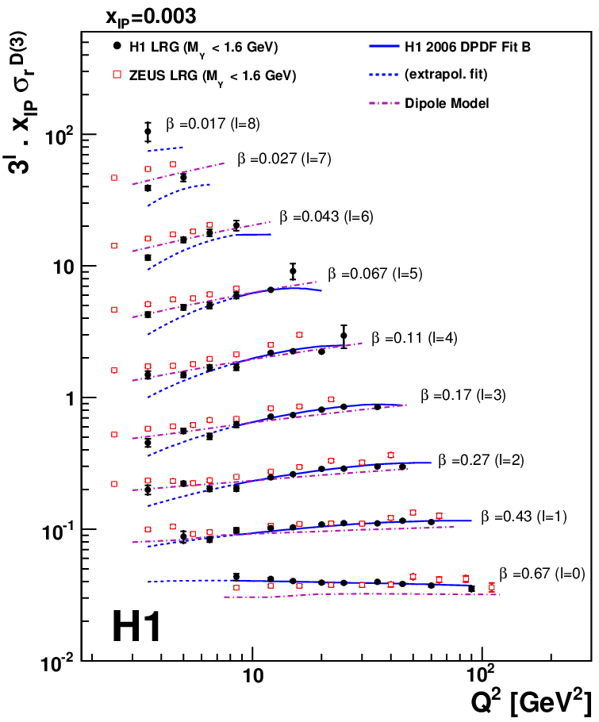
Inclusive Diffractive DIS at HERA
Combined H1 measurements
LRG method
Increase in statistics
reduction of uncertainties
the dipole model can describe the low Q² kinematic domain better than H1 DPDF ﬁts.
DPDF ﬁts are more successful to describe the region of high Q²
EPJ C72 (2012) 2074

Slide 11
Factorisation
QCD factorisation - rigorously proven
DPDFs – obey DGLAP,
universal for diff. ep DIS
hard scattering
cross section
proton vertex factorisation - conjecture
pomeron flux factor
pomeron PDF

Slide 12
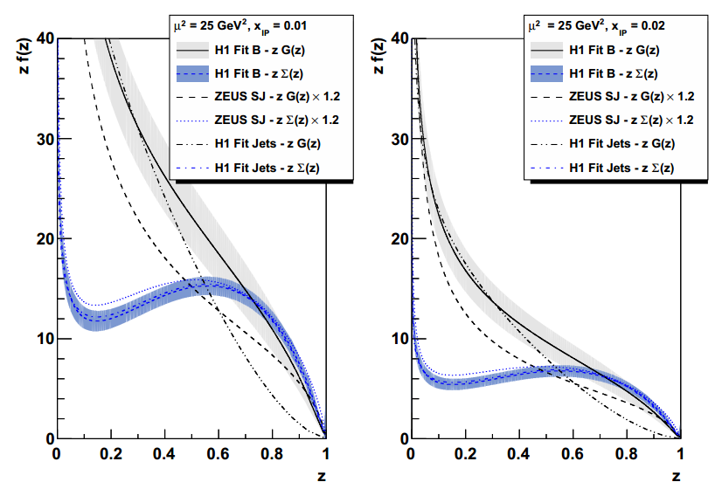
Diffractive PDFs
DPDFs obtained by H1 and ZEUS from inclusive, dijet
z - the longitudinal four-momentum fraction of the parton entering the hard sub-process with respect to pomeron
R.Zlebcik,K.Cerny,A.Valkarova,EPJ C71, (2011) 1741

Slide 13
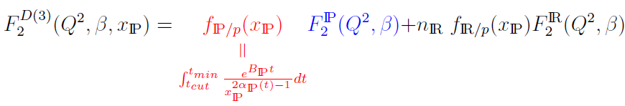
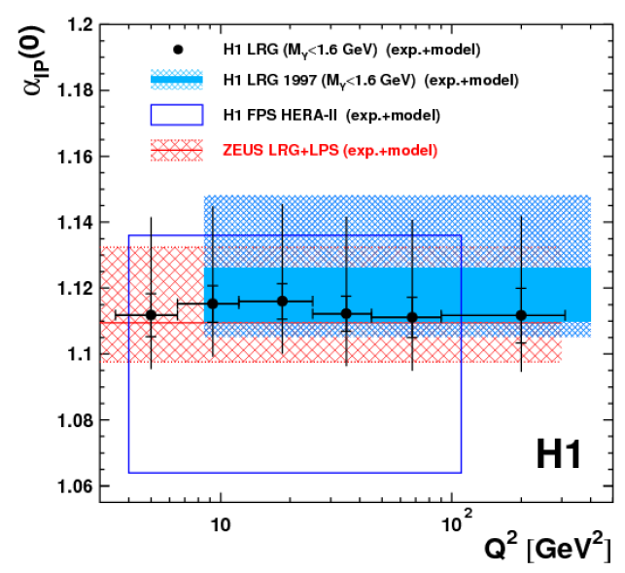
Inclusive Diffractive DIS at HERA: Pomeron Trajectory
EPJ C72 (2012) 2074
parameterised
α_{IP}(0) = 1.113 ± 0.002 (exp)^{+0.029}_{-0.015} (mod)
No Q² dependence observed
Agreement with previous measurements
Consisted with “soft” pomeron
Supports proton vertex factorisation

Slide 14
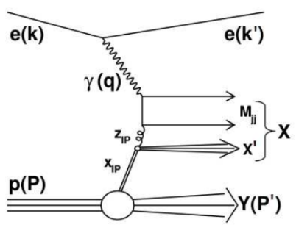
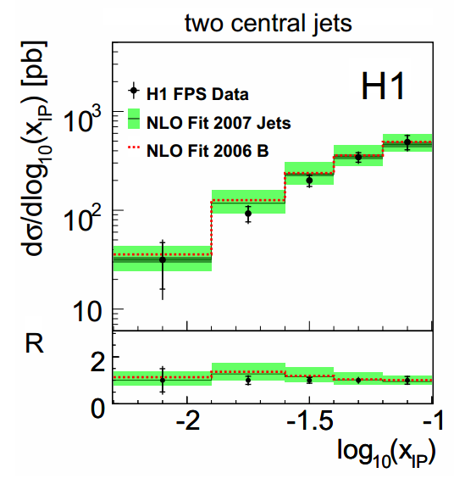
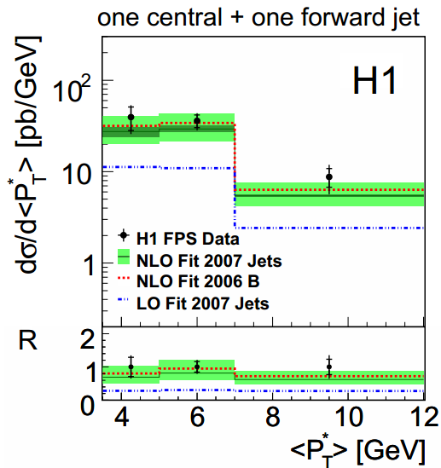
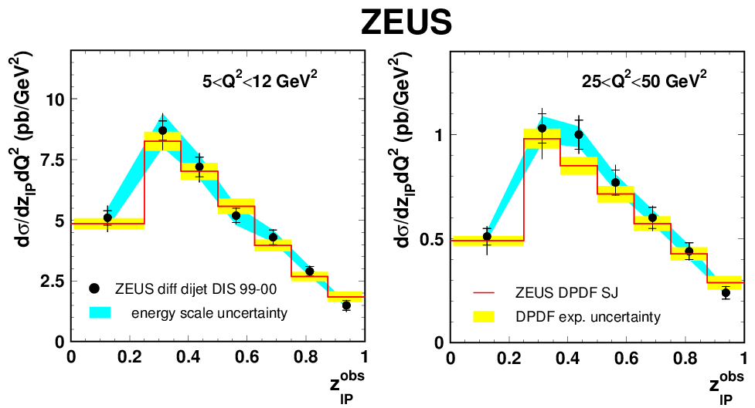
Diffractive dijets in DIS
two hard scales in the process:
  the virtuality of the photon
  the transverse energy of the jets
sensitivity to the gluon given by the production mechanism of the dijets
  Boson-Gluon Fusion processes
The dijets in DDIS as a benchmark for the dPDFs and the factorisation theorem
Supports universality of DPDFs
The dijets data can be used to constrain the dPDFs in a combined with the inclusive data
Nucl. Physics B 831 (2010) 1-25
EPJ C72 (2012) 1970

Slide 15
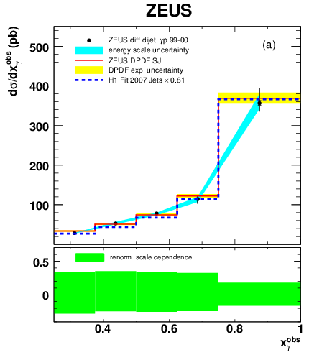
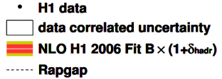
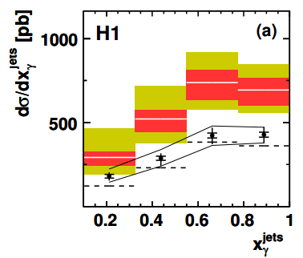
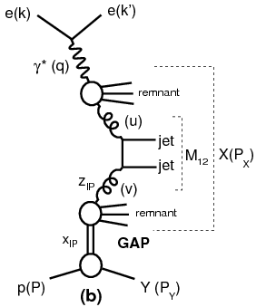
Diffractive dijets in PhP
For dijet in DIS: the factorisation holds
For dijets in PhP HERA results not fully decisive
  different phase space
  different selection of PhP tagged electron H1 vs. untagged ZEUS
factorisation breaking observed by H1 but not observed by ZEUS
in p − p collisions (TeVatron) the factorisation is broken
real photon (Q² ≃ 0) can develop a hadronic structure
resolved photoproduction theory predicts suppression
the suppression is supposed to be stronger at low scales and low x,
however no dependence of suppression-factor visible
?

Slide 16
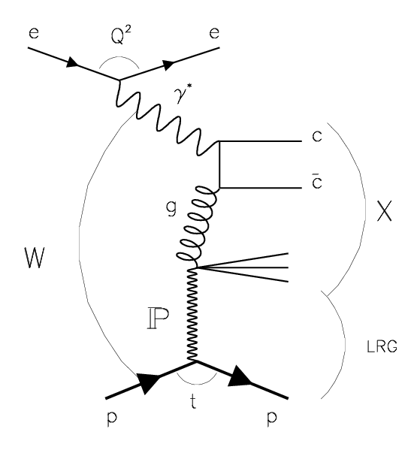
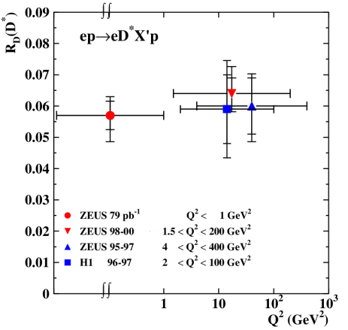
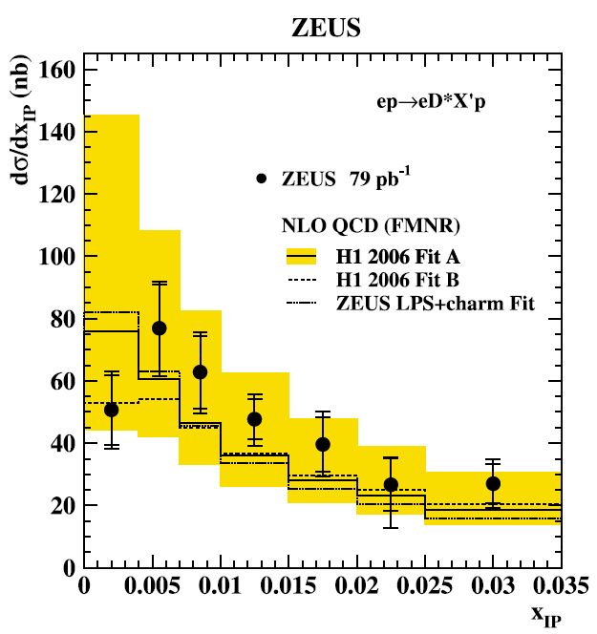
Diffractive photoproduction of D∗±(2010) at HERA
Charm provides a hard scale, ensuring the applicability of pQCD even for low Q²
mainly via direct photon reactions
is sensitive to the gluon content of the diffractive exchange
The NLO QCD calculations reproduce the x_{IP} differential cross section in both shape and normalization.
Supports the QCD factorisation theorem in diffraction, implying the universality of diffractive PDFs
Large experimental and theoretical uncertainties
Fraction R_{D} is approximately independent of Q²
Eur. Phys. J. C 51 (2007) 301-315

Slide 17
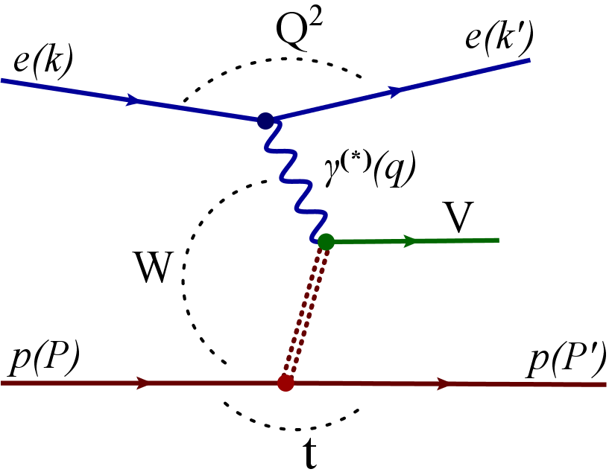
Vector Meson production

Slide 18
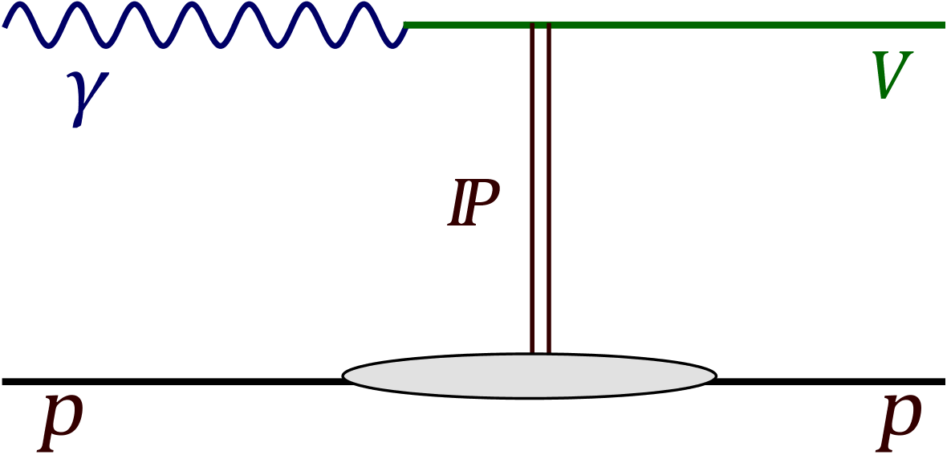
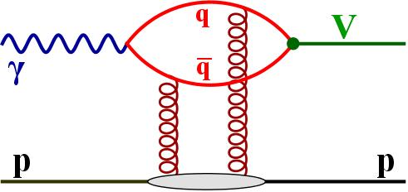
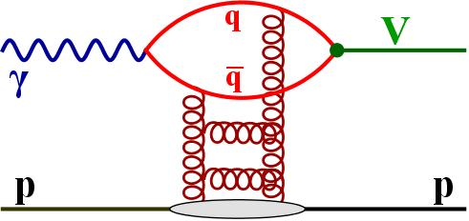
Vector Meson production
Soft physics: Vector Dominace Model, Regge theory
In presence of a hard scale (M_{VM}, Q², t) calculations in pQCD are possible

Slide 19
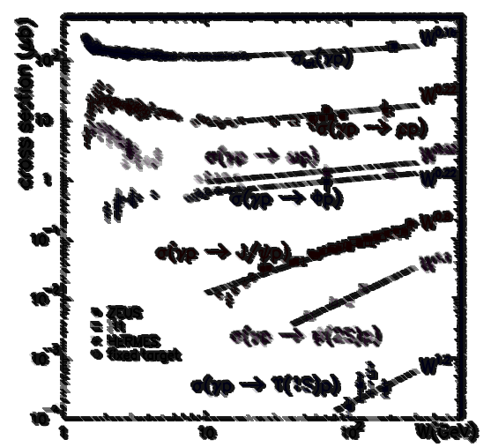
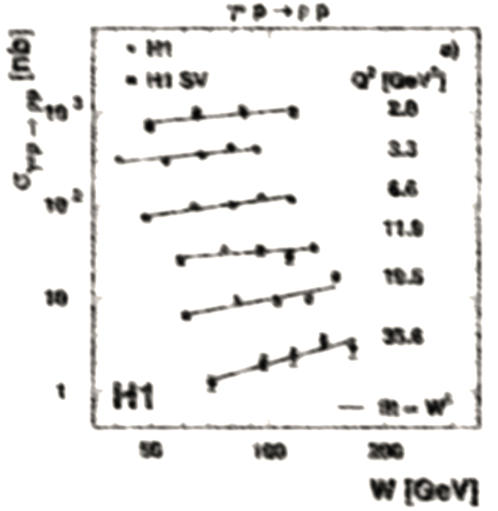
Vector Meson production: W-dependence
The cross section dependence on W can be parameterised as: σ ∝ W_{γp}^{δ}

Slide 20
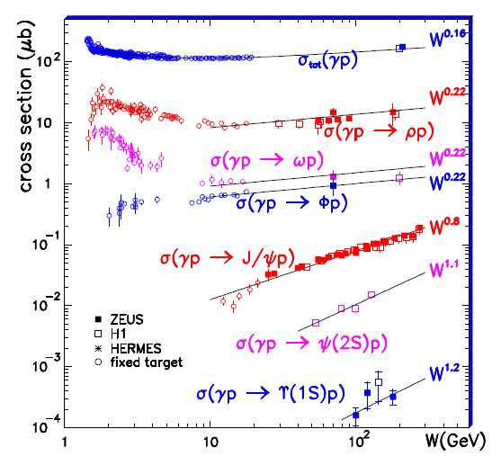
Vector Meson production: W-dependence
The cross section dependence on W can be parameterised as: σ ∝ W_{γp}^{δ}
photoproduction
The rapid rise of cross section with Wγp , can be explain by increasing gluon density with decreasing of fractional momentum x ∝ 1/W_{γp}²

Slide 21
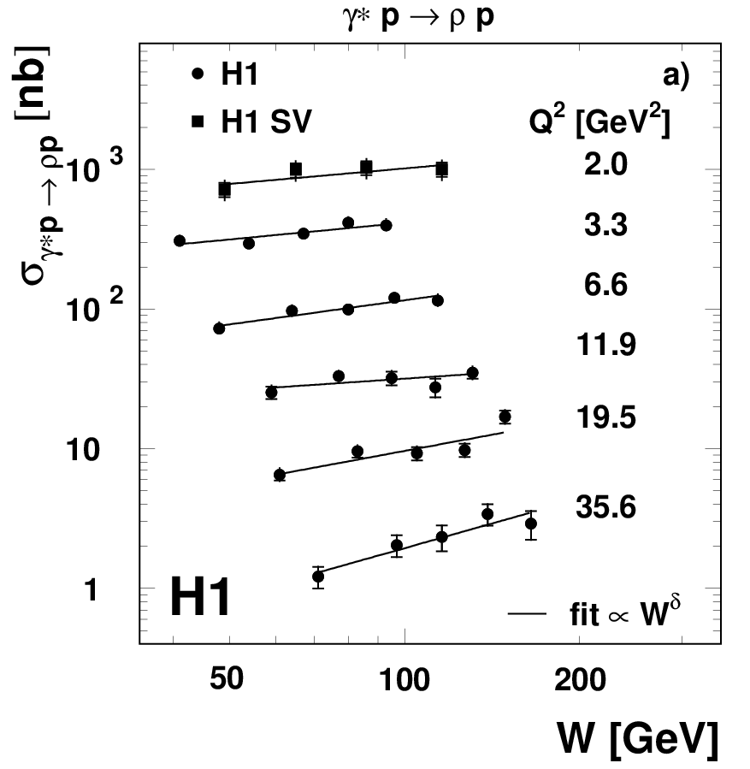
Vector Meson production: W-dependence
The cross section dependence on W can be parameterised as: σ ∝ W_{γp}^{δ}
photoproduction
electroproduction (DIS)
The rapid rise of cross section with Wγp , can be explain by increasing gluon density with decreasing of fractional momentum x ∝ 1/W_{γp}²

Slide 22
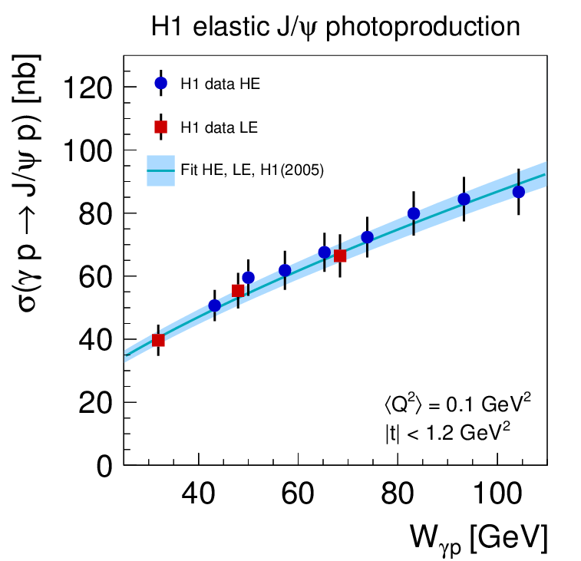
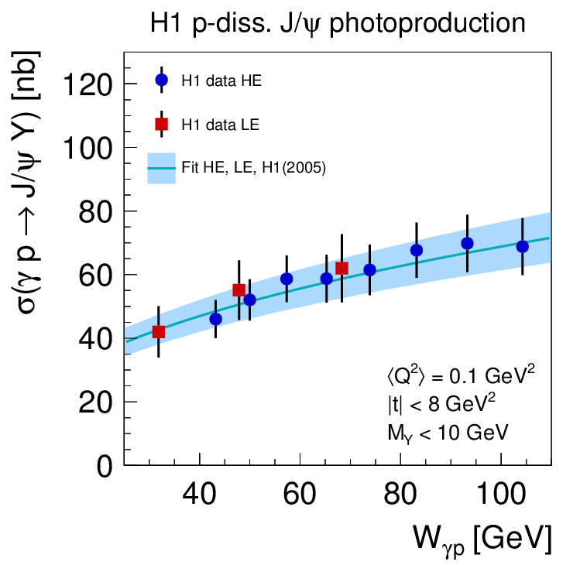
Elastic and p-diss cross sections as a function of Wγp
Phys. J. C73 (2013) 2466
Fit model:
  Parametrisation (for elastic and p-diss.):
σ = N (W_{γp} / W₀ )^{δ} with W₀ = 90GeV
Simultaneous fit of elastic and p-diss cross sections:
  including correlations, including previous H1 hep-ex/0510016
Results:
γp → J/ψp: δ_{el} = 0.67 ± 0.03
γp → J/ψY: δ_{pd} = 0.42 ± 0.05
δ_{el} = δ_{pd} - δ_{el} : -0.25 ± 0.06
A dependence of cross section ratio as a function of W_{γp} is observed

Slide 23
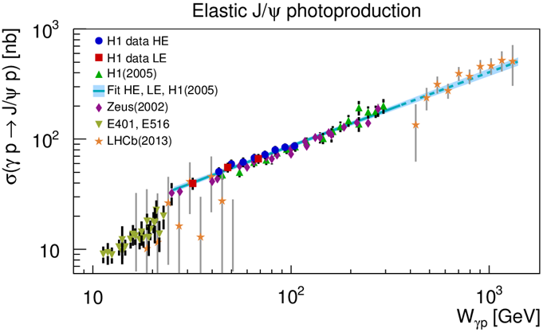
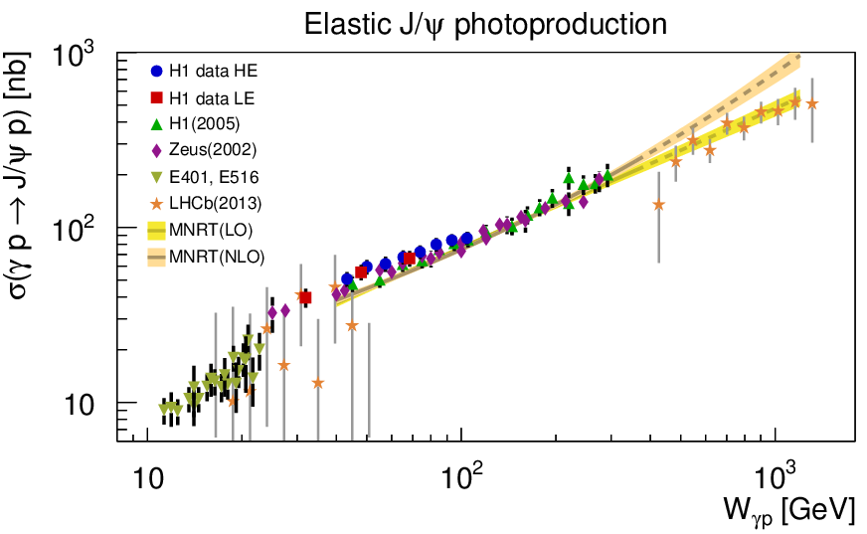
Comparison to other experiments
H1 measurement in the transition region from fixed target to previous HERA data
Good agreement with previous HERA measurements
Fixed target data: steeper slope, lower normalization
Fit to H1 data extrapolated to higher Wγp describes the LHCb data
LO and NLO fit to previous J/ψ data and extrapolated to higher Wγp.
Phys. J. C73 (2013) 2466

Slide 24
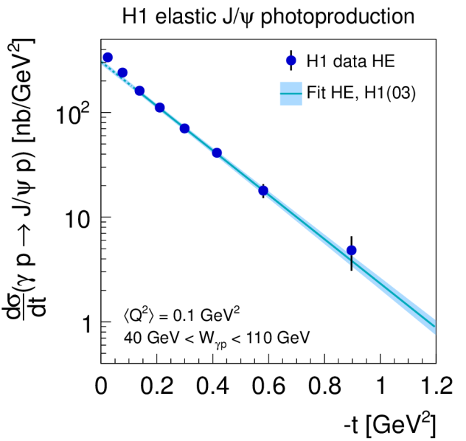


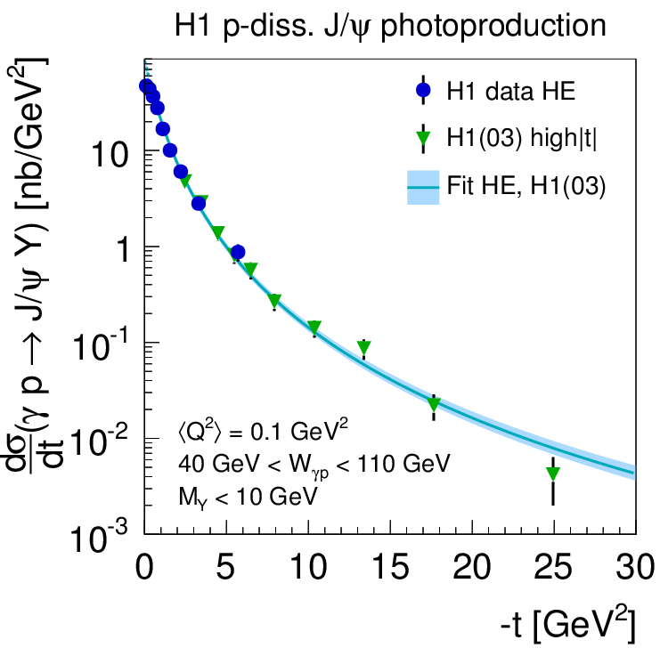
p-diss cross sections as a function of t
The t-dependence of elastic cross section carries information about the transverse size of the interaction region
  elastic:
p-diss cross section dominant for | t | > 1 GeV²
  p-diss:
Results:
HE: γp → J/ψp: b_{el} = (4.88 ± 0.15) GeV⁻²
γp → J/ψY: b_{pd} = (1.79 ± 0.12) GeV⁻² n = 3.58± 0.15
Phys. J. C73 (2013) 2466
The new data extend the reach to small values of |t|
Good agreement in overlap region

Slide 25
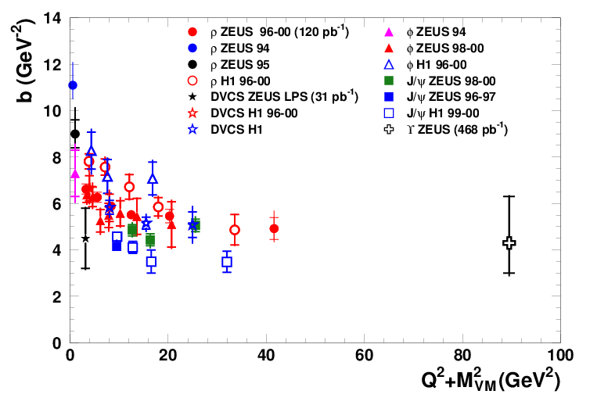
VM production and DVCS: b(Q²+M²_{VM})
Phys.Lett.B 708 (2012) 14
Analysis doubles the explored range
In agreement with an asymptotic behaviour of Q² + M²_{VM}
In optical model approach: b ≈ (R²_{p} + R²_{VM})/4
The first measurement of b-slop:
b = 4.3 ^{+2.0}_{-1.2}^{+0.5} _{-0.6} GeV⁻²
consistent with predictions based on pQCD models (b= 3.68 GeV⁻²) Cox, Forshaw, Sandapen, JHEP 0906 (2009) 034
size of interaction region is getting smaller with Q² + M²_{VM}

Slide 26
Summary
HERA delivers diffractive results since 21 years with many interesting measurements using different experimental methods, and more ...
  Session: Small-x, Diffraction and Vector Mesons:
  Session: Heavy Flavours:
Marcin Guzik (ZEUS): | Exclusive dijet production in diffractive deep inelastic scattering at HERA
Jan Olsson (H1): | Analysis of Feynman Scaling in Photon and Neutron Production in the Very Forward Direction in Deep-Inelastic Scattering at HERA
Radek Zlebcik (H1): | Diffractive Dijet Production with Leading Proton in ep Collisions at HERA
Sergey Levonian (H1): | Exclusive Photoproduction of Rho Meson with Leading Neutron at HERA
Boris Pokorny (H1): | Dijet production with large rapidity gap in deep-inelastic scattering at HERA
Nataliia Kovalchuk (ZEUS): | Recent results on Charmonium production at HERA

Slide 27
Summary
Combined spectrometer data provide better precision
Hard diffraction is present, dominated by gluons
Inclusive Diffraction measurements support proton vertex factorisation
Diffractive factorisation confirmed by dijet measurements in DIS
The suppression that takes place for the dijet diffractive photoproduction is not yet understood
NLO QCD calculations provides good description of open charm php data
Vector meson production provides opportunity to test the property of diffraction and proton structure

Slide 28
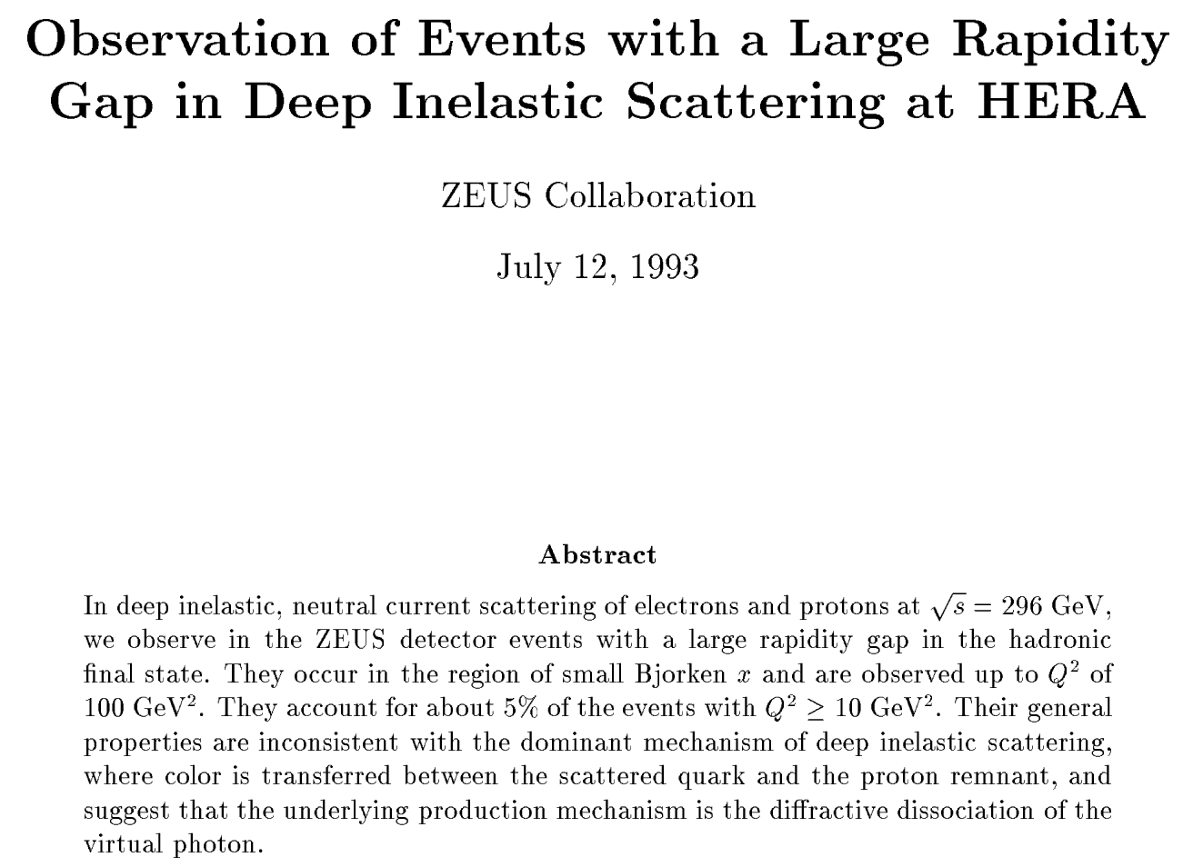
21 years of diffraction @ HERA
Thank you for attention

