Slide 1
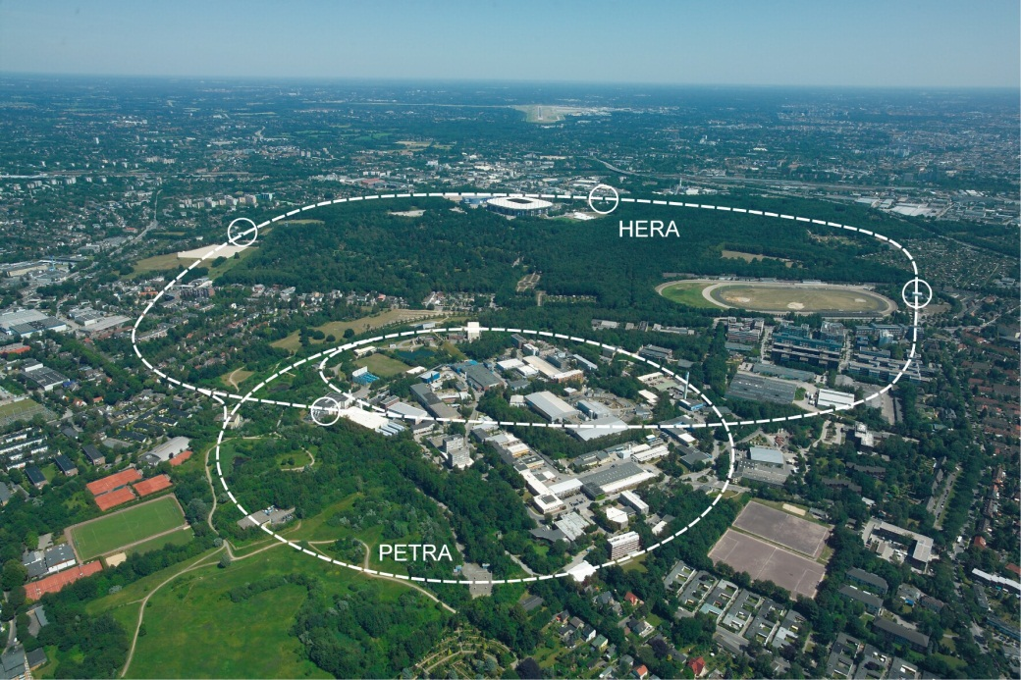
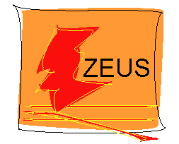

Proton Structure and Hard QCD
AM Cooper-Sarkar, Oxford
Phys Rev D93(2016)092002

Slide 2
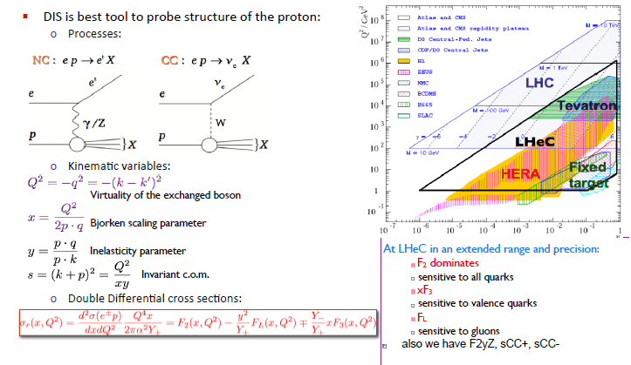
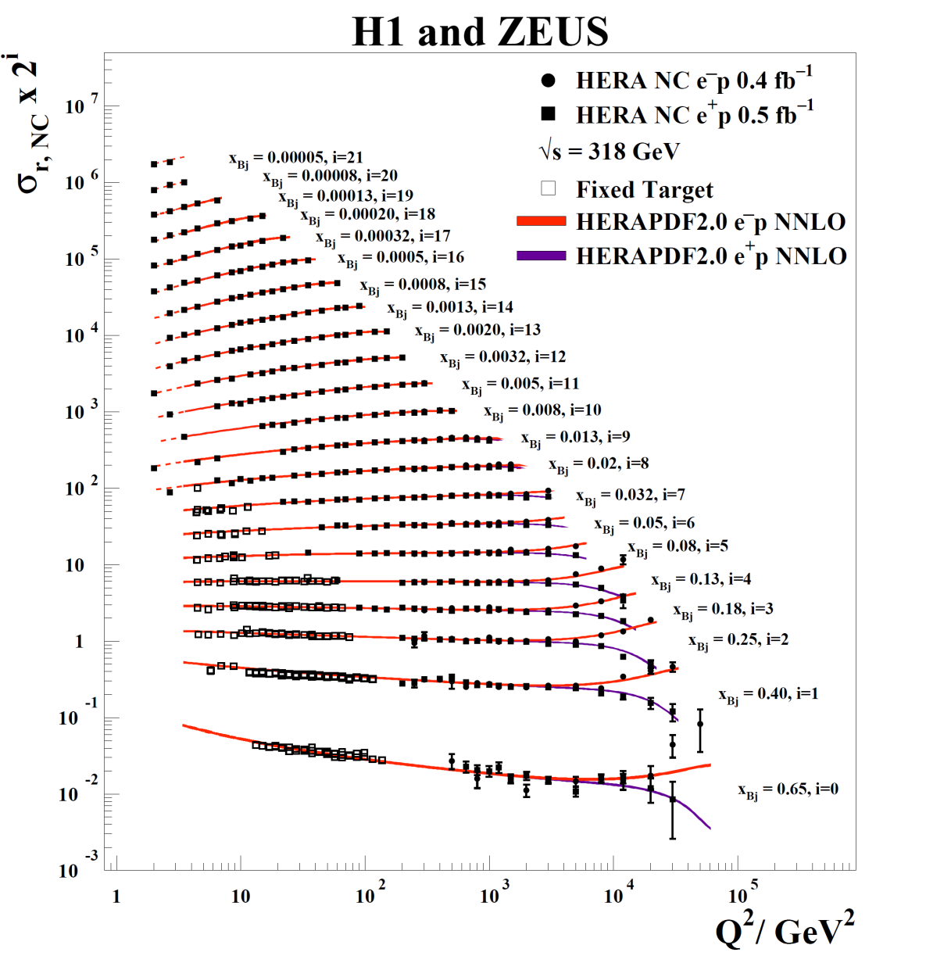
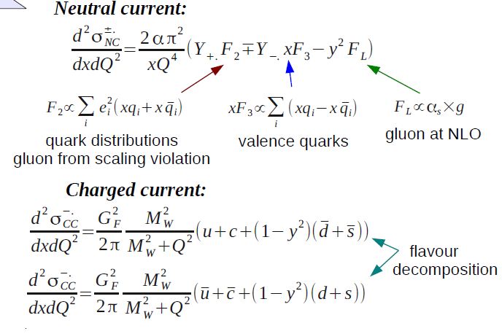
Deep Inelastic Scattering (DIS) is the best tool to probe proton structure
LO expressions
Gluon from the scaling violations: DGLAP equations tell us how the partons evolve

Slide 3
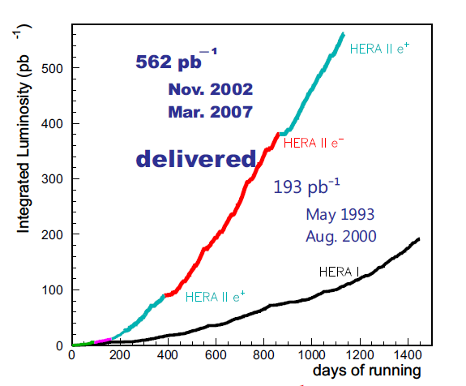
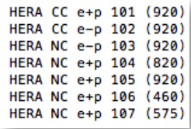
Final inclusive data combination from all HERA-1+11 running
~500pb⁻¹ per experiment split ~equally between e⁺ and e⁻ beams: DESY-15-039
10 fold increase in e⁻ compared to HERA-I
Running at Ep = 920, 820, 575, 460 GeV
√s = 320, 300, 251, 225 GeV
The lower proton beam energies allow a measurement of F_{L} and thus give more information on the gluon.
41 input data files to 7 output files with 169 sources of correlated uncertainty
0.045 < Q² < 50000 GeV² 6. 10⁻⁷ < x_{Bj} < 0.65

Slide 4
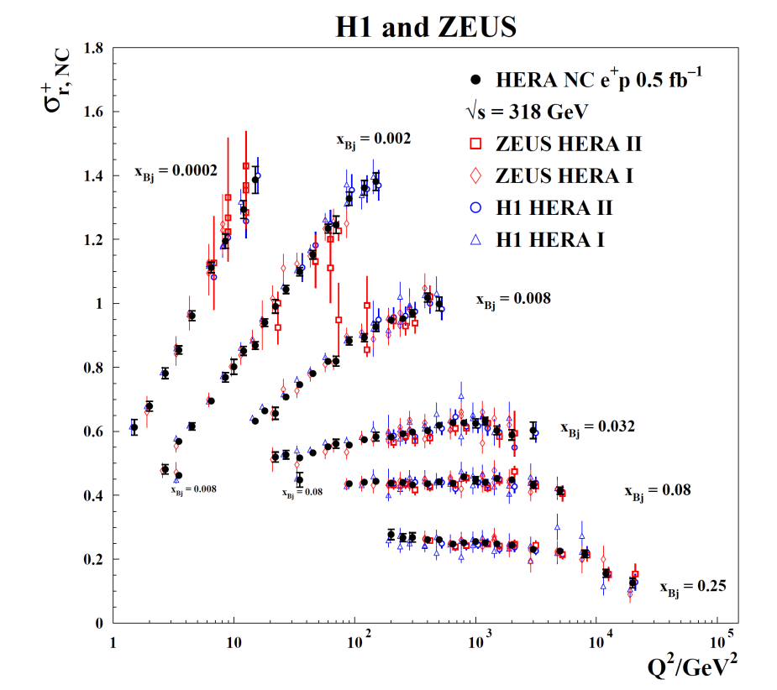
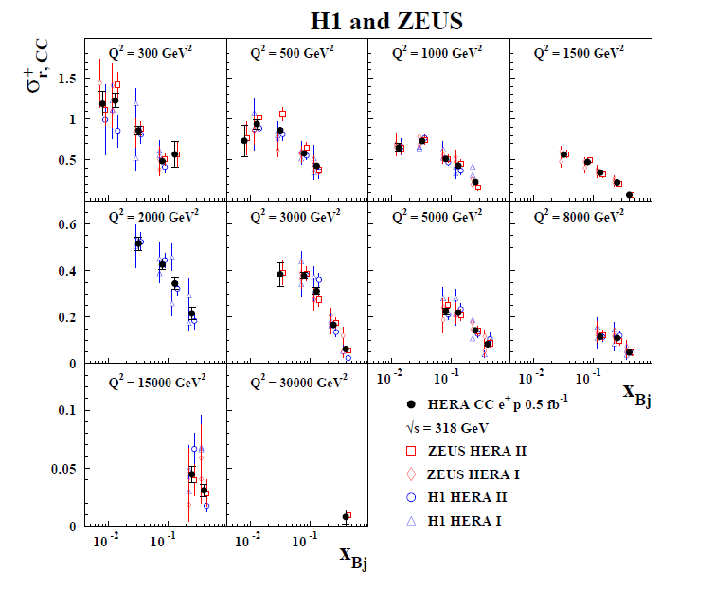
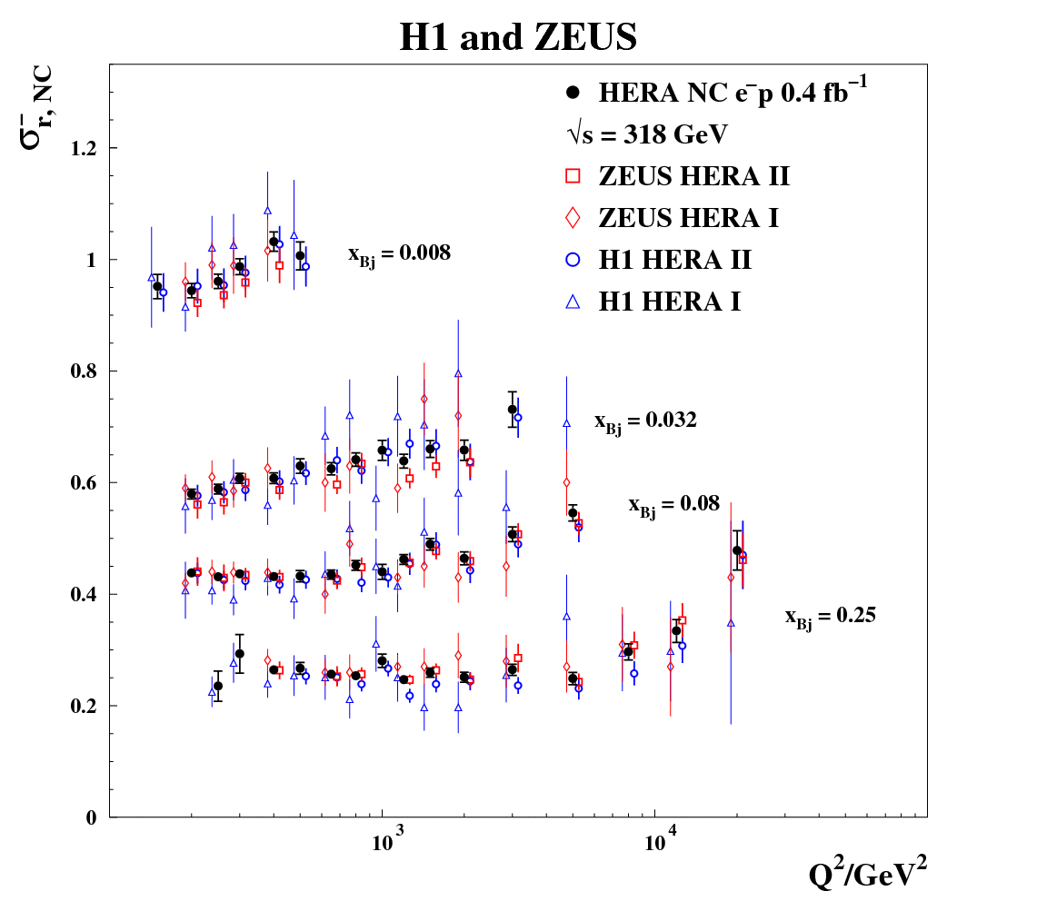
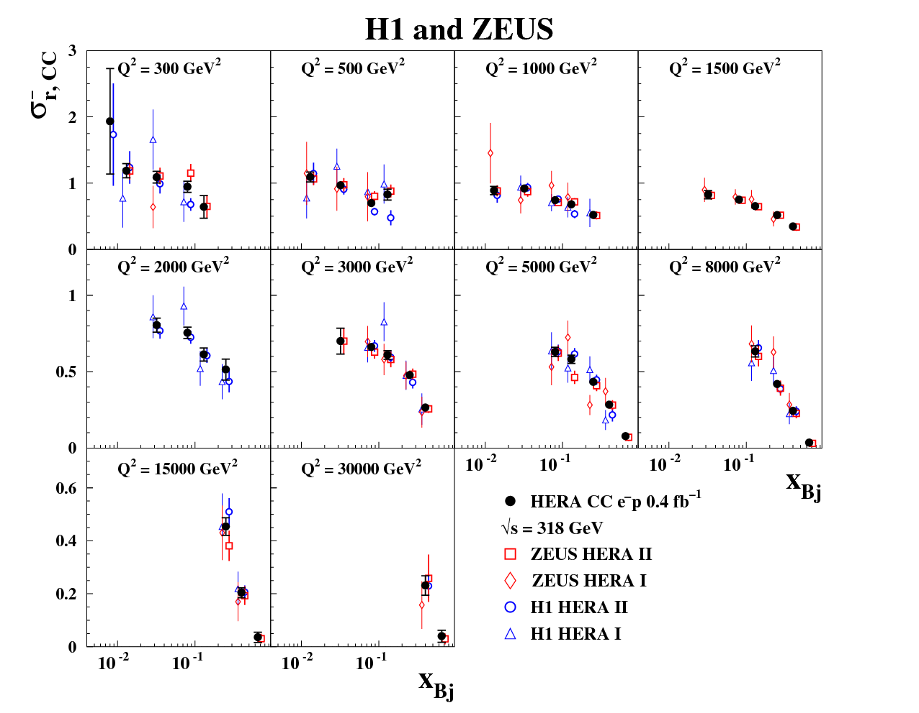
NC and CC e⁺ vs H1 and ZEUS inputs
NC and CC e⁻ vs H1 and ZEUS inputs
10 fold increase in e⁻ statistics compared to old HERA-1 combination

Slide 5
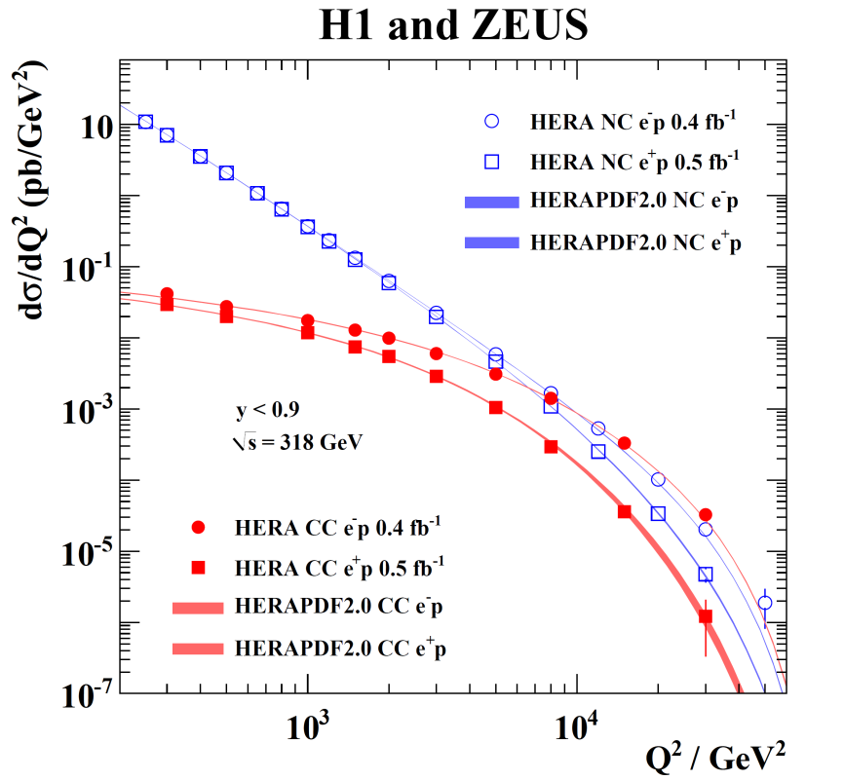
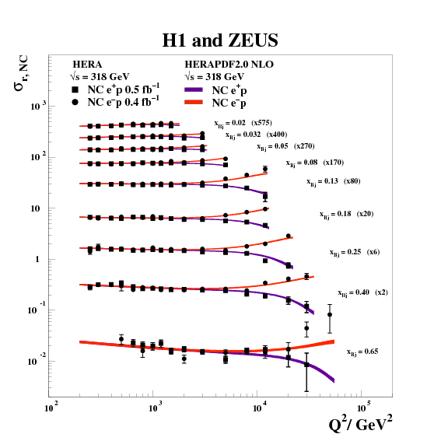
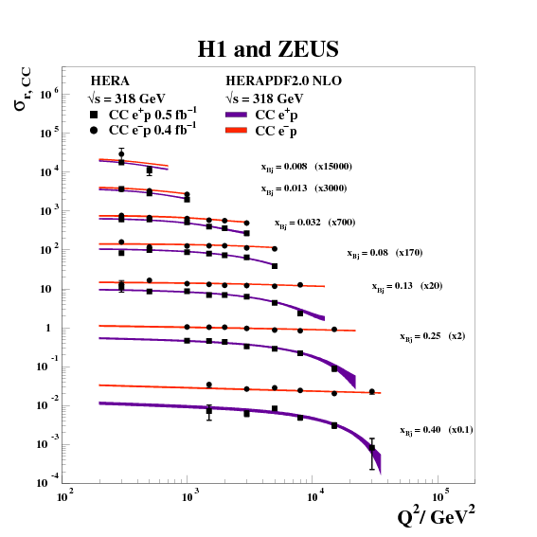
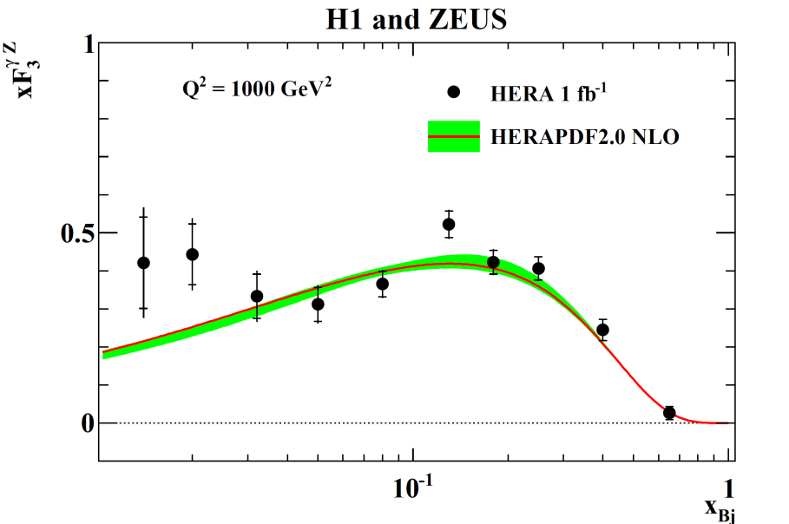
Electroweak unification
NCe⁺/NCe⁻ difference at high Q² due to γZ interference
CCe⁺/CCe⁻ difference at high Q² .. due to (1-y)² suppression at high y
These plots already show the QCD fit HERAPDF2.0
Enables an extraction of xF3

Slide 6
The HERAPDF approach uses only HERA data
The combination of the HERA data yields a very accurate and consistent data set for 4 different processes: e⁺p and e⁻p Neutral and Charged Current reactions and for e⁺p Neutral Current at 4 different beam energies
The use of the single consistent data set allows the usage of the conventional χ2 tolerance Δχ2 = 1 when setting 68%CL experimental errors
NOTE the use of a pure proton target means no need for heavy target/deuterium corrections.
d-valence is extracted from CC e⁺p without assuming d in proton= u in neutron
All data are at high W (> 15 GeV), so high-x, higher twist effects are negligible.
These are the only PDFs for which this is true
HERAPDF evaluates model uncertainties and parametrisation uncertainties in addition to experimental uncertainties
HERAPDF1.0 was based on the combination of HERA-I data
HERAPDF1.5 included preliminary HERA-II data
HERAPDF2.0 is based on the new final combination of HERA-I and HERA-II data which supersedes the HERA-I combination and supersedes all previous HERAPDFs

Slide 7
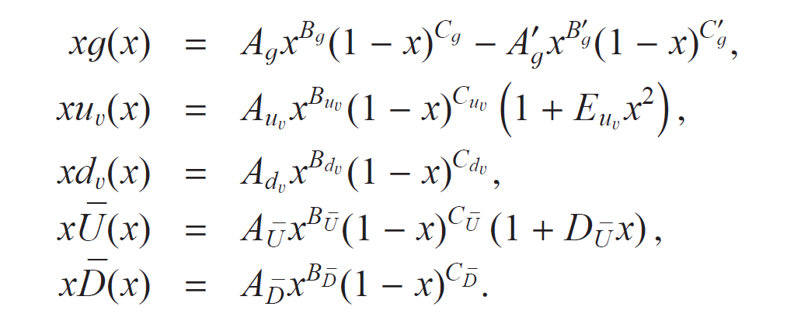




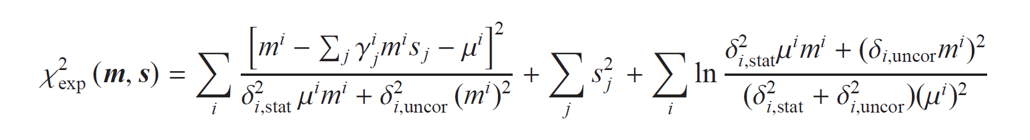
HERAPDF specifications: parameterisation and χ2 definition
For the NLO and NNLO fits the central parametrisation at Q²₀ = 1.9 GeV² is
QCD sum-rules constrain A_{g},A_{uv},A_{dv}
sets the size of the strange PDF and the constraints and
ensure
There are 14 free parameters in the central fit determined by saturation of the χ2
α_{S}(M_{Z}) = 0.118 for central fits
PDFs are evolved using the DGLAP equations using QCDNUM and convoluted with coefficient functions to evaluate structure functions and hence measurable cross sections
Heavy quark coefficient functions are evaluated by the Thorne Roberts Optimized Variable Flavour Number scheme – this is the standard, unless otherwise stated
Fixed Flavour Number PDFs are also available at NLO
An LO fit with α_{S}(M_{Z}) = 0.130 is also provided with an alternative gluon (AG) parametrisation
The form of the χ2 accounts for 169 correlated uncertainties, 162 from the input data sets and 7 from the procedure of combination

Slide 8
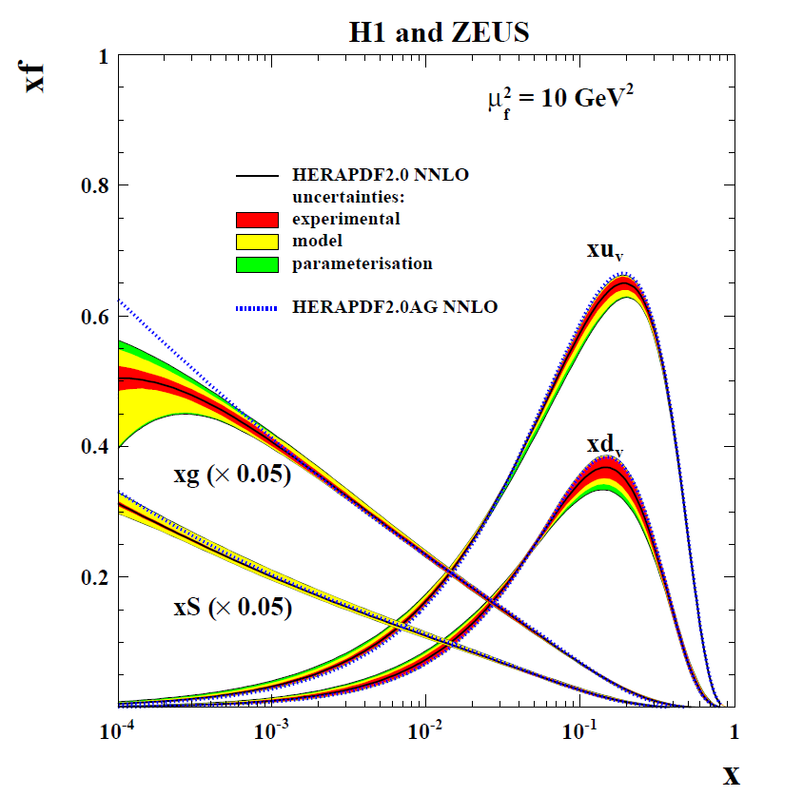
HERAPDF specifications: sources of uncertainty
Experimental
Hessian uncertainties: 14 eigenvector pairs, evaluated with Δχ2 = 1
Cross checked uncertainties evaluated from the r.m.s. of MC replicas
Model: Variation of input assumptions
Variation of charm mass and beauty mass parameters is restricted using HERA charm and beauty data
Variation | central | Upper | lower
f_{s} size and shape | 0.4 | 0.5 | 0.3
M_{c} (NLO) GeV | 1.43 | 1.49 | 1.37
M_{c} (NNLO) GeV | 1.47 | 1.53 | 1.41
M_{b} GeV | 4.5 | 4.25 | 4.75
Q²_{min} GeV² | 3.5 | 2.5 | 5.0
Q²_{min}(HiQ2) | 10.0 | 7.5 | 12.5
Parametrisation
Variation of Q²₀ = 1.9 ± 0.3 GeV² and addition of 15th parameters
The value of α_{S}(M_{Z}) is not treated as an uncertainty. The central value is α_{S}(M_{Z}) = 0.118 But PDFs are supplied for α_{S}(M_{Z}) values from 0.110 to 0.130 in steps of 0.001

Slide 9
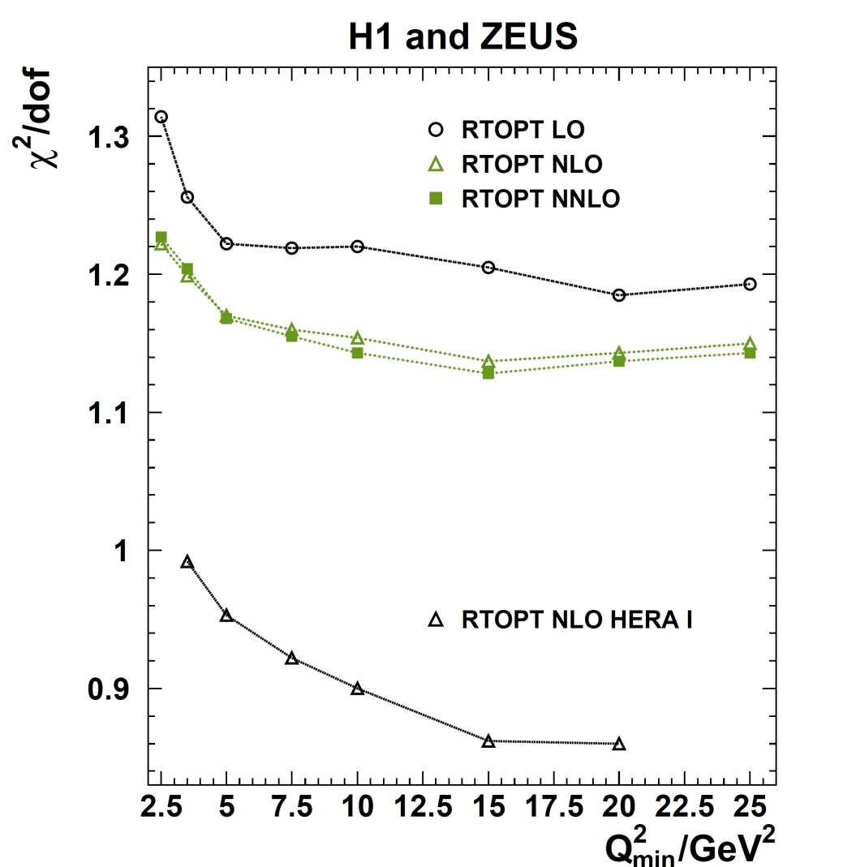
HERAPDF specifications: minimum value of Q²
A minimum value of Q² for data allowed in the fit is imposed to ensure that pQCD is applicable. For HERAPDF the usual value is Q² > 3.5 GeV² but consider the variation of χ2 with this cut
The χ2 decreases with increase of Q² minimum until Q²_{min} ~ 10 -15 GeV²
The same effect was observed in HERA-1 data
This is independent of heavy flavour scheme
NLO is obviously better than LO but NNLO is not significantly better than NLO, for RT
Fits for two Q² cuts were presented: HERAPDF2.0: Q² > 3.5 and
HERAPDF2.0HiQ2: Q² >10 GeV²
HERA kinematics is such that cutting out low Q² also cuts the lowest x values, thus HERAPDF2.0HiQ2 is used to assess possible bias in HERAPDF2.0 from including a kinematic region which might require treatment of: non-perturbative effects; ln(1/x) resummation; saturation etc.

Slide 10
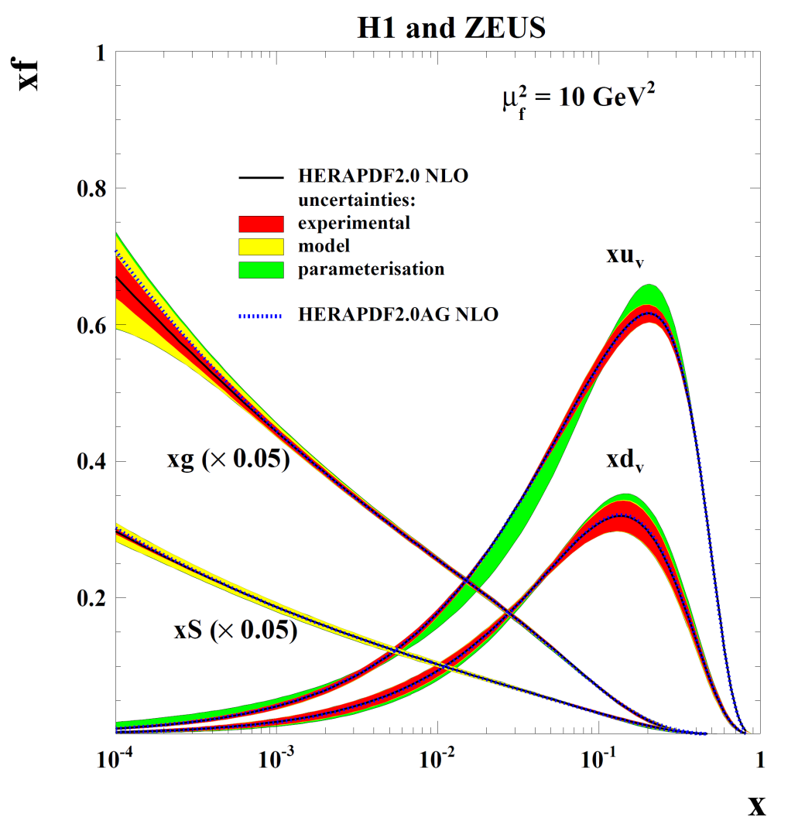
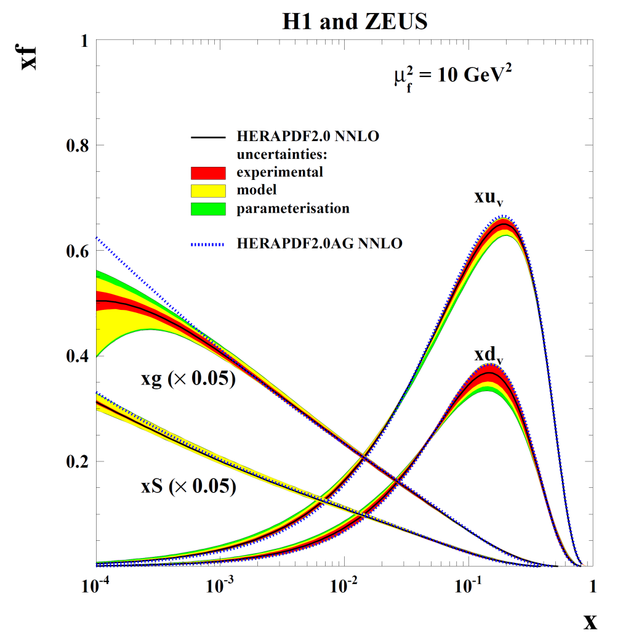
HERAPDF2.0: NLO and NNLO fits
NLO
NNLO
Q2>3.5
The HERAPDF2.0AG is an alternative gluon parametrisation which is positive definite for all x and all Q² > Q²₀

Slide 11
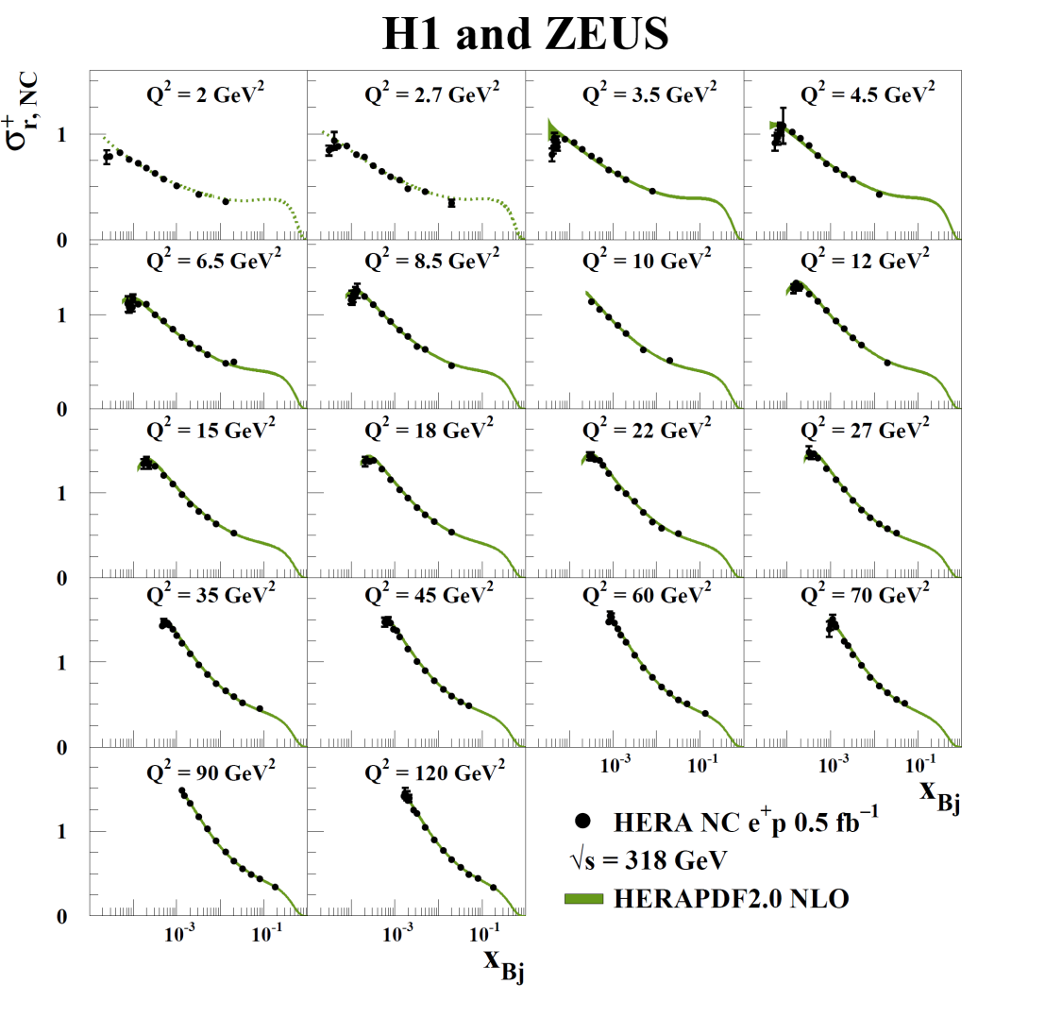
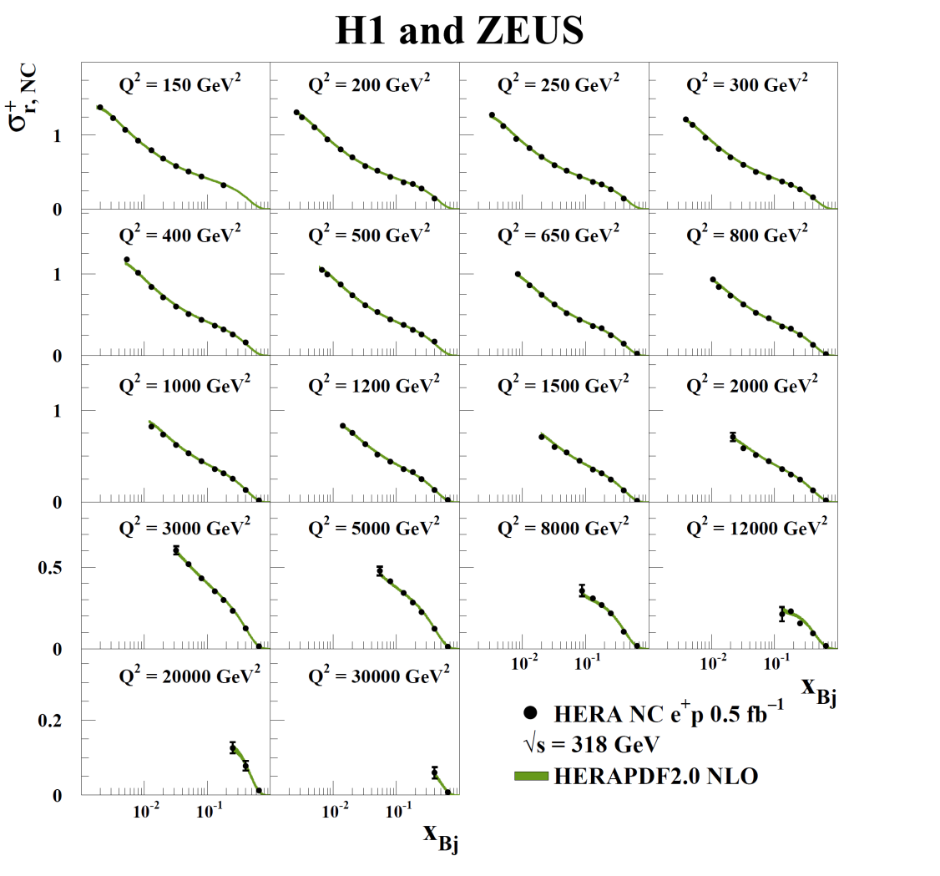
HERAPDF2.0 compared to data
Here is the comparison to the NC e⁺ data for 2 < Q² < 30000 GeV²
NLO and NNLO fits look very similar

Slide 12
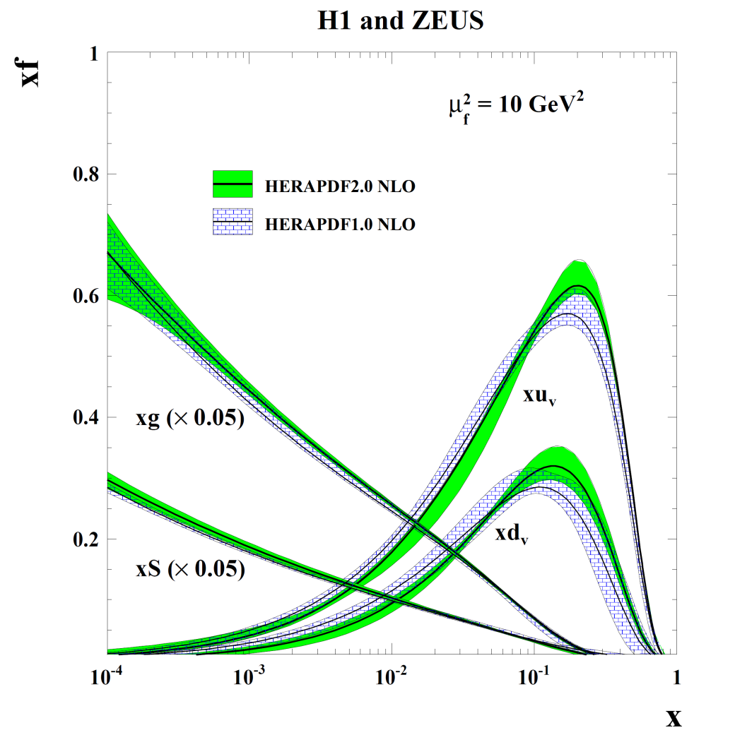
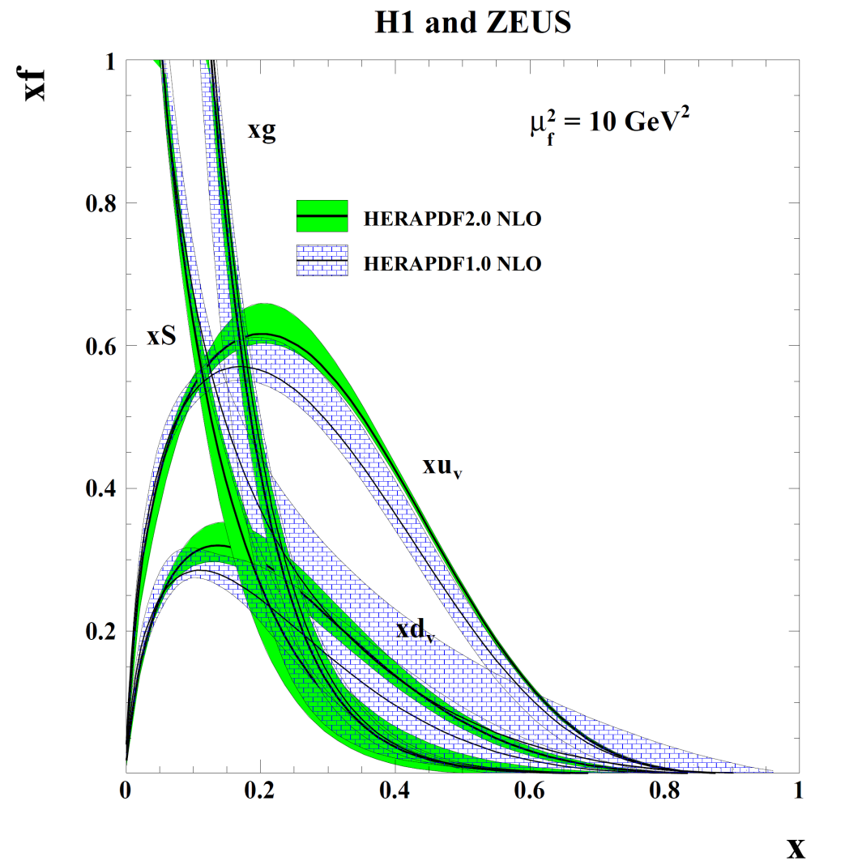
Compare HERAPDF2.0 to HERAPDF1.0 at NLO
Much more high-x data
Substantial reductions in high-x uncertainty
Some change in valence shape
HERAPDF1.0 (and 1.5) had rather hard high-x sea, harder than the gluon (within large uncertainties).This is no longer the case and uncertainties are much reduced
HERAPDF1.0 and 1.5 had a soft high-x gluon this moves to the top of its previous error band- but is still soft (at NLO)

Slide 13
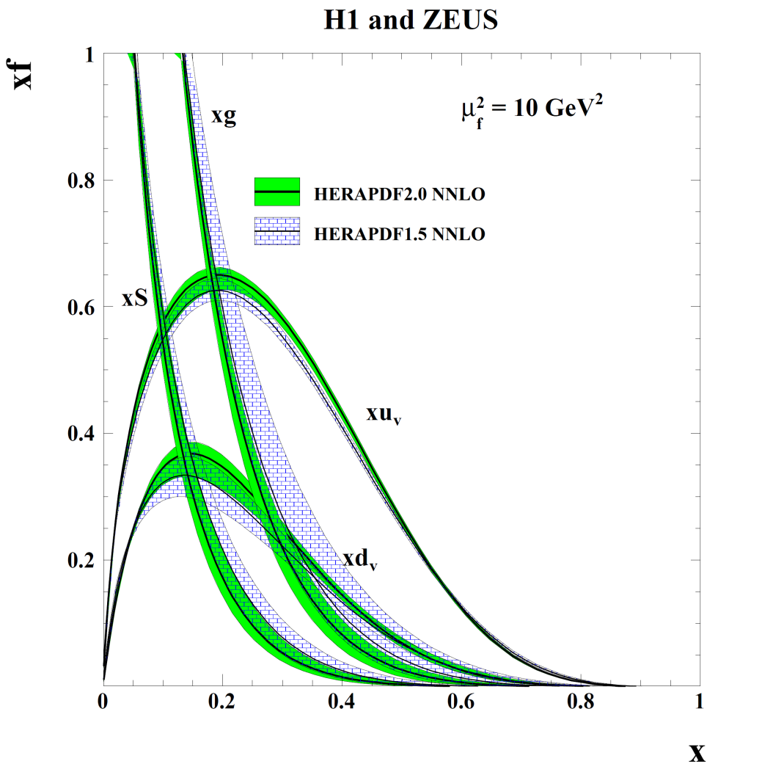
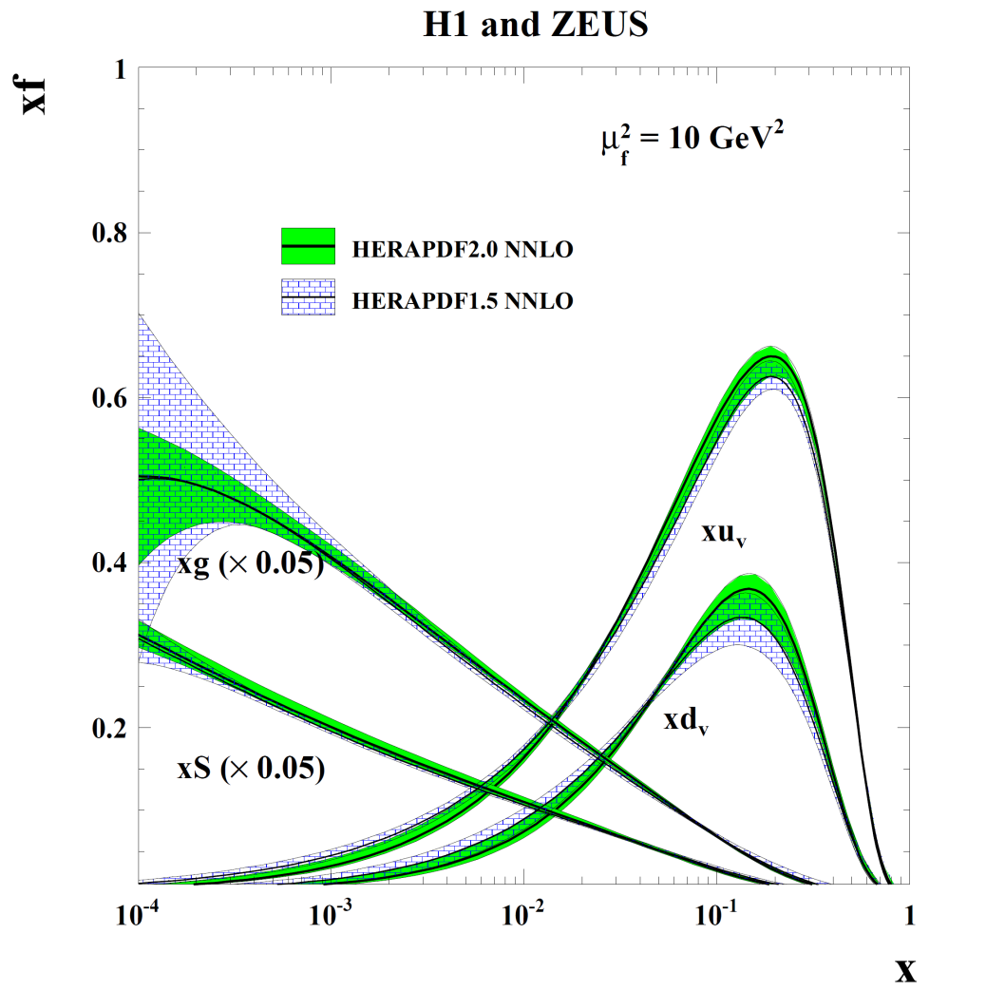
Compare HERAPDF2.0 to HERAPDF1.5 at NNLO
Reduction in gluon uncertainty both at low-x and high-x.
A lot of this reduction is because the model variation due to variation of Q² cut is not as dramatic now that we have more data.
The HERAPDF1.5 gluon was not soft compared to global PDFs. However it had a large error band.
This uncertainty on the gluon decreases and the central value moves to the lower end of its previous error band

Slide 14
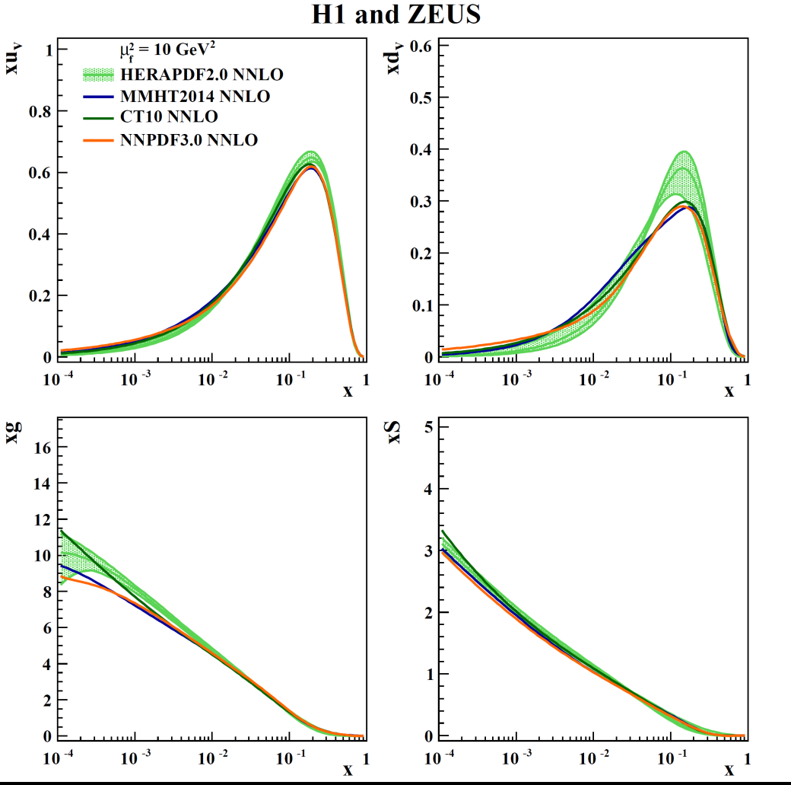
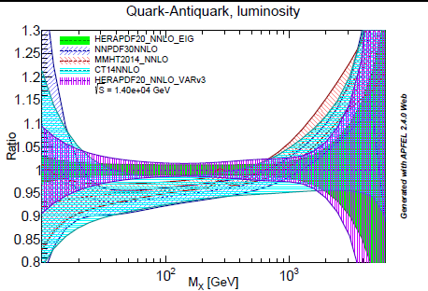

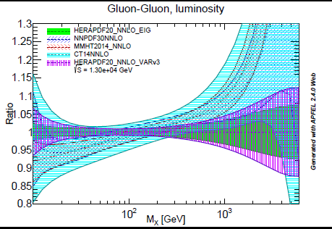
Compare HERAPDF2.0 to other PDFs at NNLO
High-x valence shapes somewhat different – new high- x data and use of proton target only. Gluon and Sea are both broadly compatible with other PDFs
Comparison of q-qbar and glu-glu luminosity
at 13 TeV show consequences for LHC

Slide 15

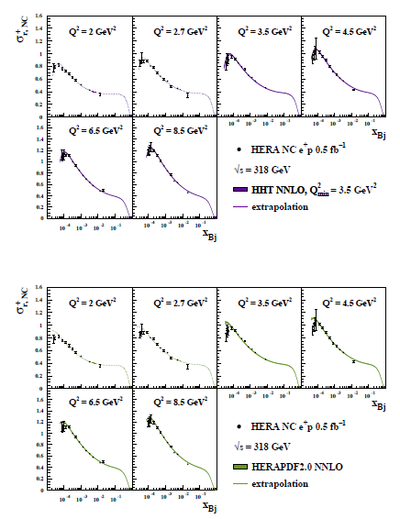
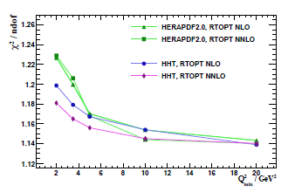
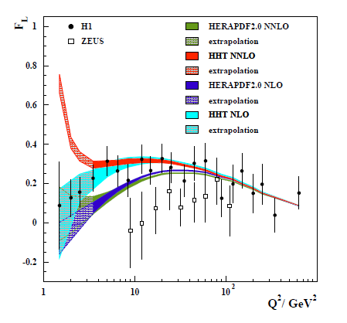
In the original HERAPDF2.0 analysis PDFs were presented for Q² > 10 GeV² as well as for Q²> 3.5 GeV². This avoids any bias from low-Q², low-x and results in PDFs which are very similar at LHC scales. However such PDFs cannot be used at low-x, low Q²
It may be better to consider adding low-x higher twist terms- HHT (arxiv:1604.02299)
The higher twist terms are only significant in F_{L}.
A larger F_{L} is predicted which fits the high-y turn over of the reduced cross section much better. This reduces the χ2 of the NNLO fit by 47.
NNLO is now better than NLO
It is still true that PDFs from these fits are similar at LHC scales
Data can be fitted down to Q² = 2GeV² - but lower Q² cannot be described in such a simple picture

Slide 16
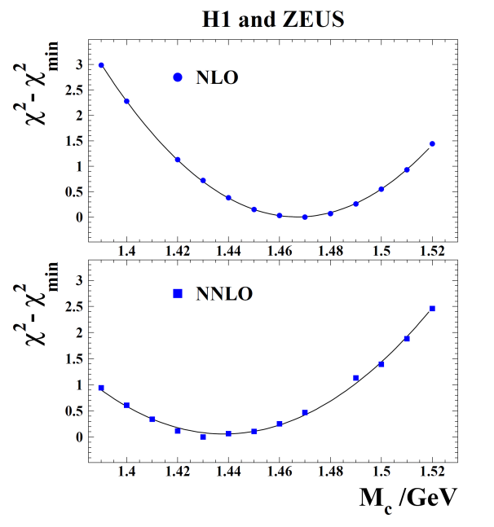
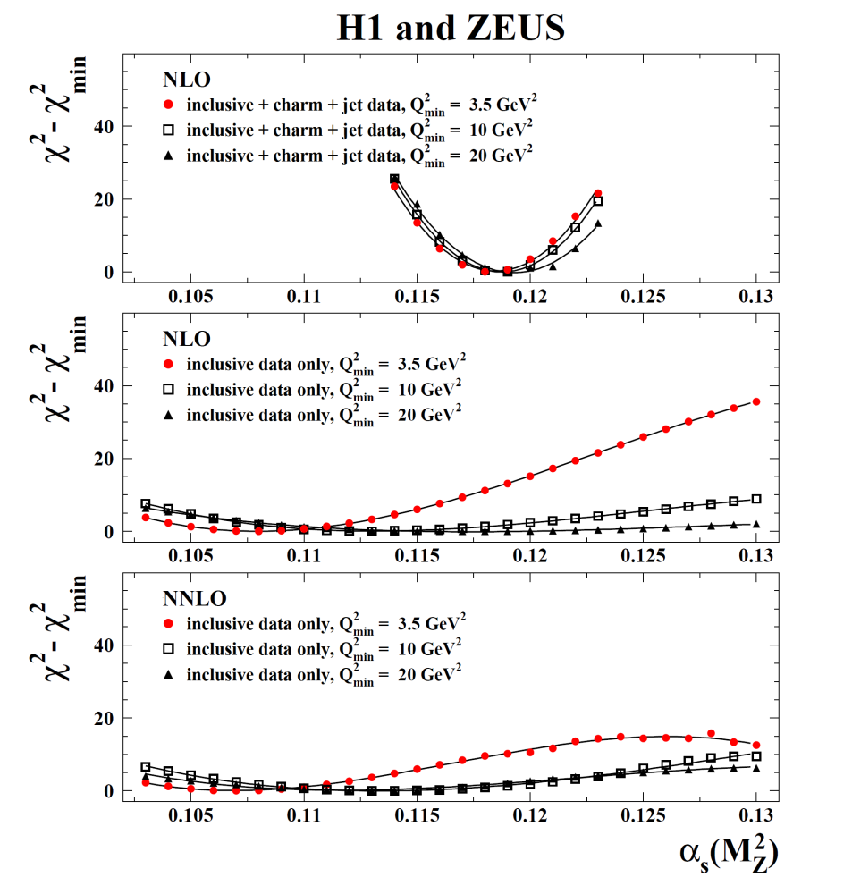
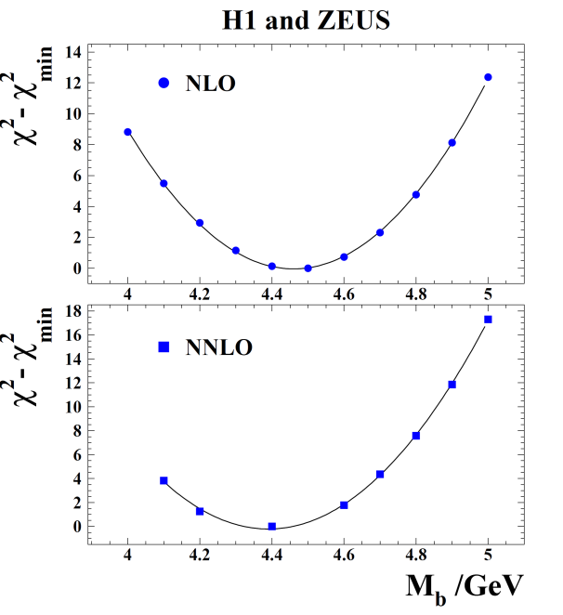
Adding more data to HERAPDF2.0: heavy flavour data and jet data
HERAPDF2.0Jets is based on inclusive + charm + jet data
The fits with and without jet data and charm data are very compatible for fixed α_{S}(M_{Z})
The main effect of heavy flavour data is to determine the optimal values of the charm and beauty mass parameters and their variation (as already done in the standard HERAPDF2.0).
This variation is much reduced compared to HERAPDF1.0
The main effect of jet data is to allow a determination of α_{S}(M_{Z}) at NLO. Inclusive data alone cannot give a reliable detrmnation.
When jet data are added one can make a simultaneous fit for PDF parameters and α_{S}(M_{Z}) at NLO--- NNLO calculation still not available
Similarly for beauty data

Slide 17
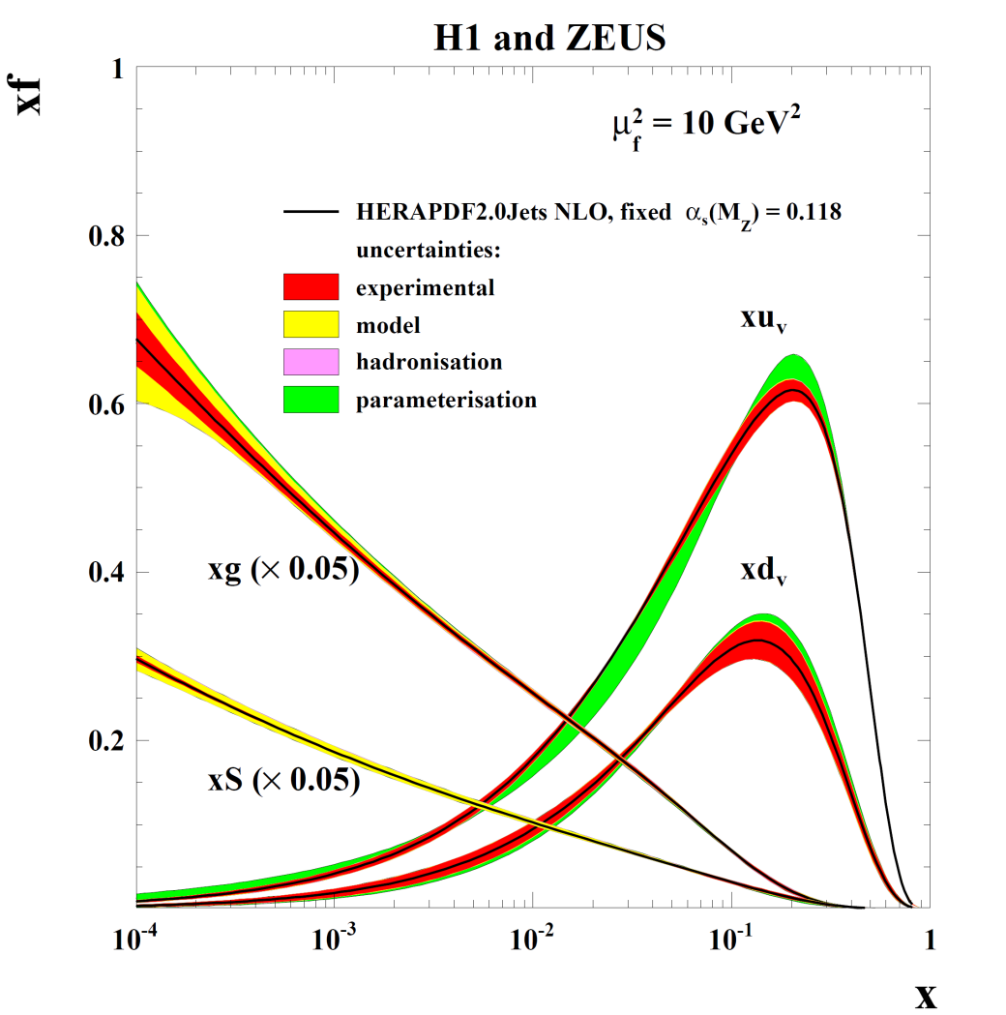
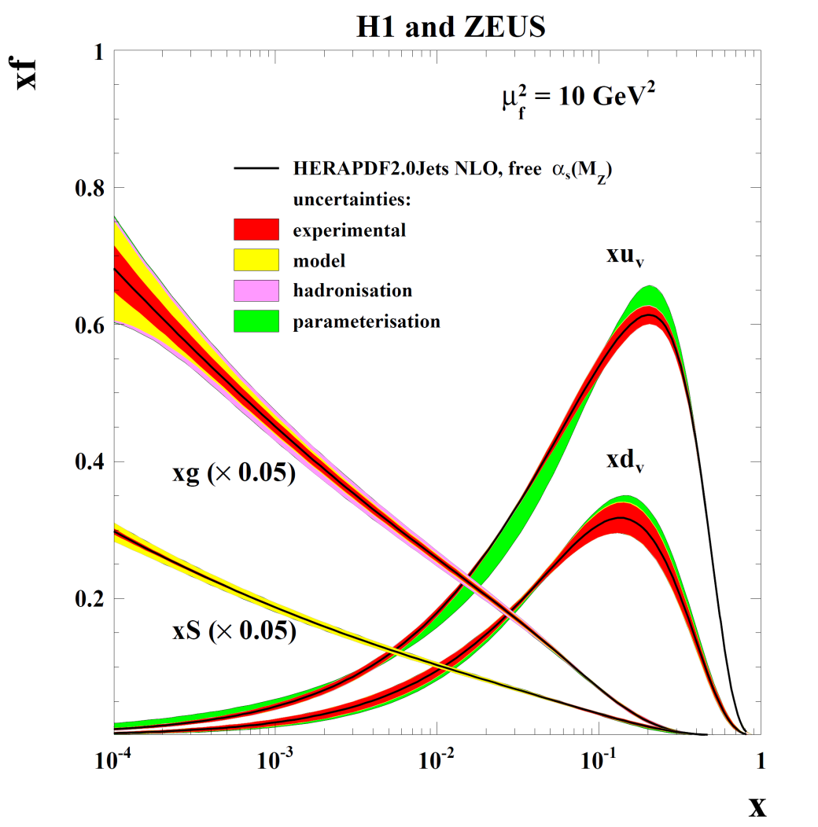

HERAPDF2.0Jets is based on inclusive + charm + jet data
Fits are made with fixed and free α_{S}(M_{Z})
These PDFs are very similar since the fitted value is in agreement with the chosen fixed value. The uncertainties of gluon are not much larger when α_{S}(M_{Z}) is free since α_{S}(M_{Z}) is well determined. Scale uncertainties are not illustrated on the PDFs
α_{S}(M _{Z}) = 0.1183 ± 0.0009_{(exp)} ± 0.0005_{(model/param)} ± 0.0012_{(had)}

Slide 18


Summary
We have the FINAL Inclusive HERA-I and II combination
And the HERAPDF2.0 series based upon it

Slide 19
Back-up
Cut out FFN PDFs
Cut out the other VFN schemes

Slide 20
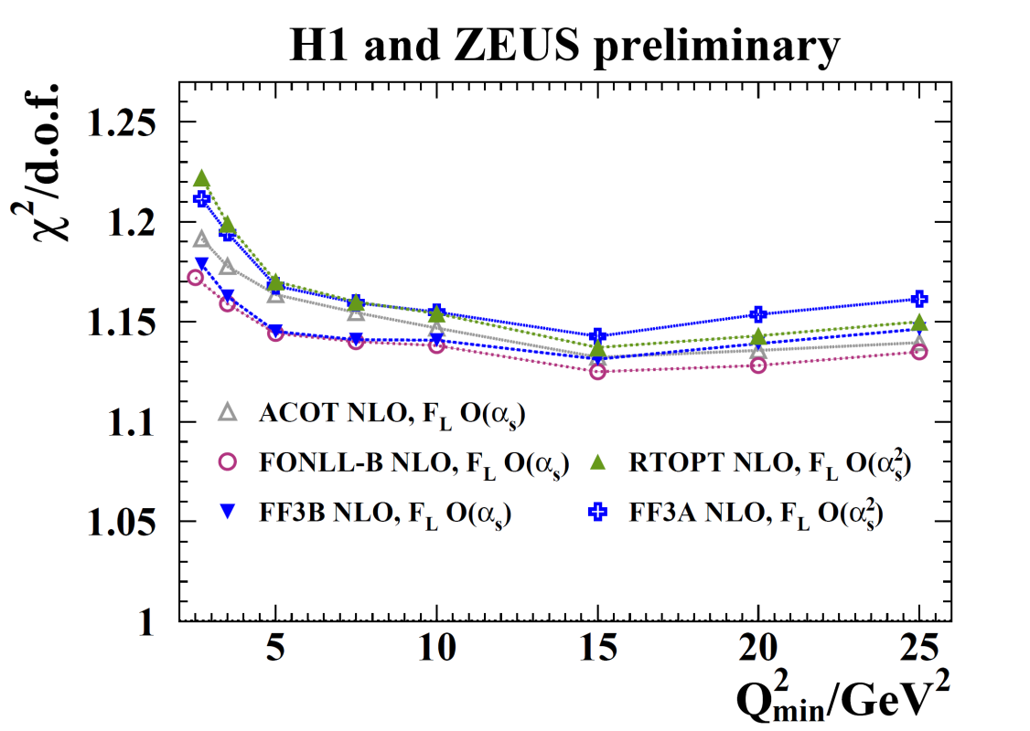
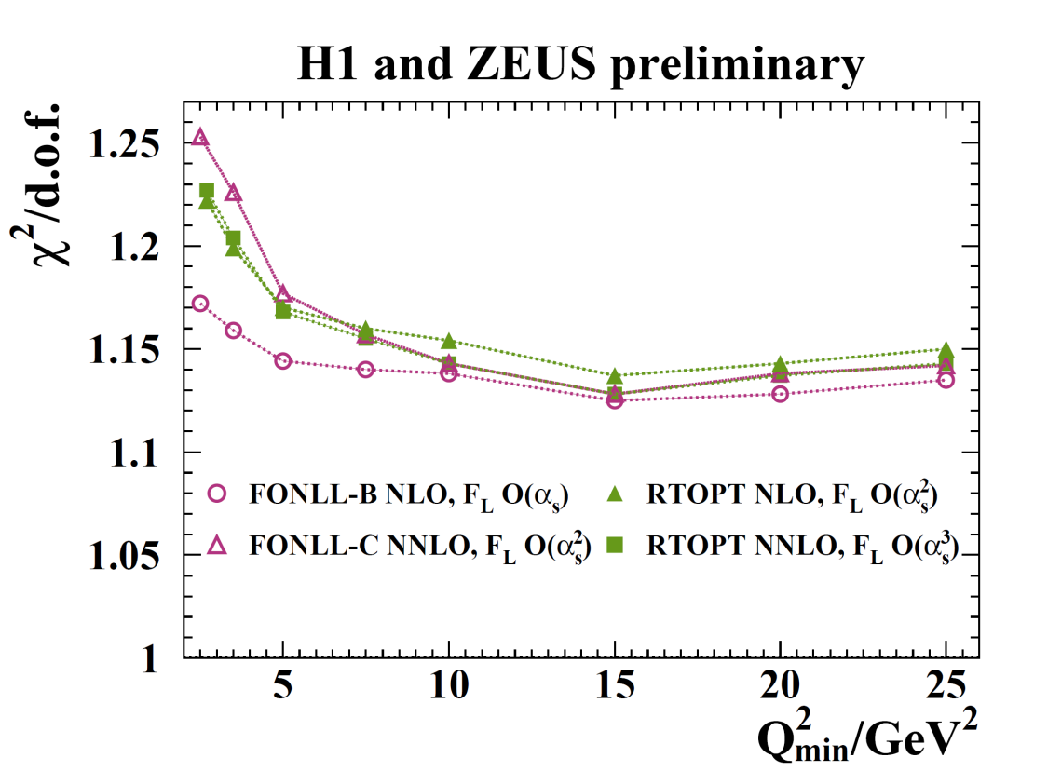
Further remarks on dependence on Q²_{min}
Compare heavy flavour schemes at NLO and compare NLO to NNLO
Treating F_{L} to O(α_{S}) – the same order as F₂ yields better χ2 than treating FL to O(α_{S}²) almost independent of heavy flavour scheme
RTOPT NNLO is marginally worse than NLO
FONLL NNLO is a lot worse than NLO

Slide 21
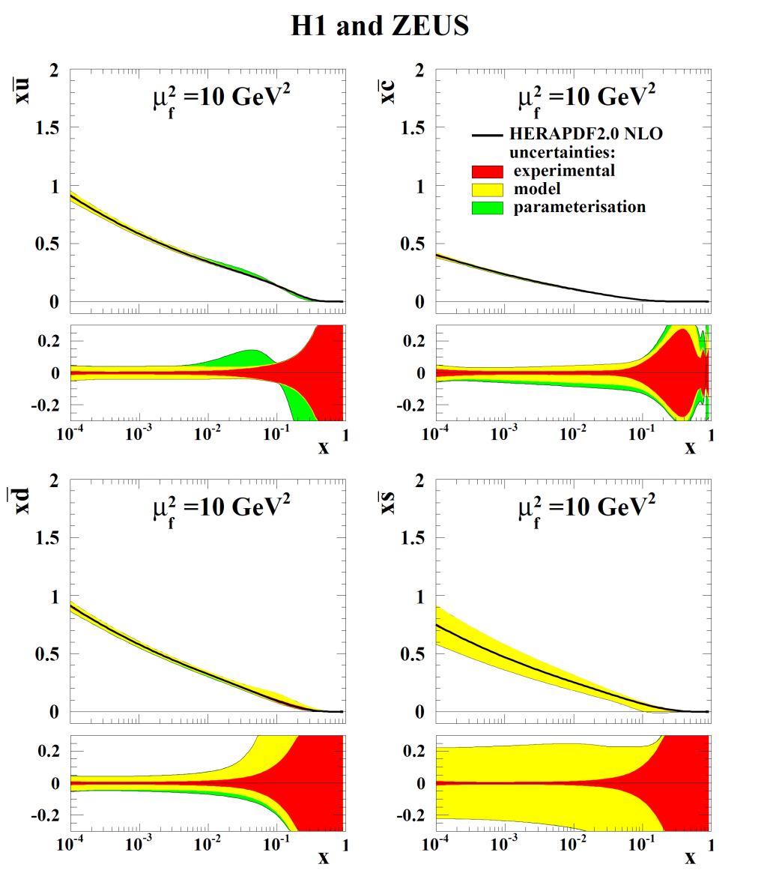
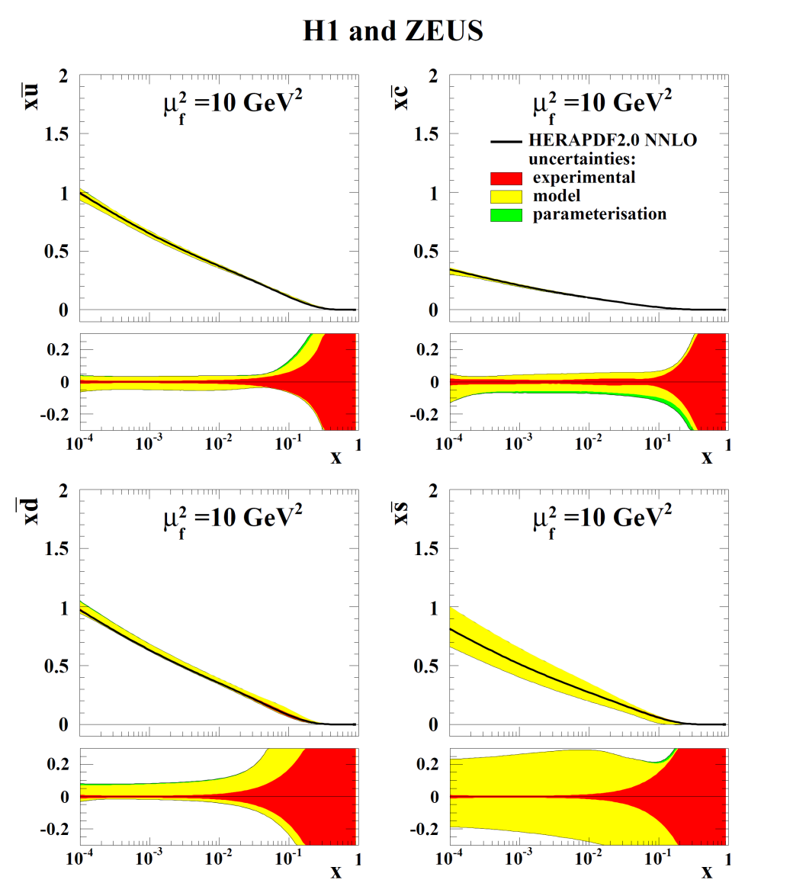
HERAPDF2.0: NLO and NNLO fits
NLO
NNLO
Flavour break-up of the sea

Slide 22
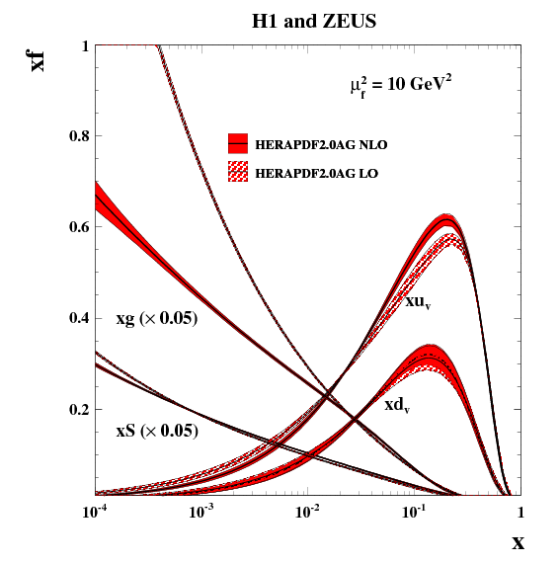
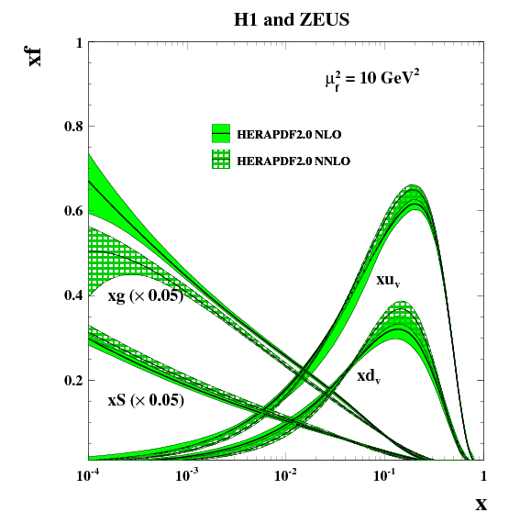
HERAPDF2.0 at LO, NLO and NNLO
HERAPDF2.0 LO is only available with experimental uncertainties and is here compared to NLO also with experimental uncertainties.
In both cases the alternative gluon parametrisation is used
HERAPDF2.0 NLO and NNLO are compared with full uncertainties.
In both cases a more flexible gluon parametrisation with a term which allows the gluon to be negative at low-x and low Q² values is used

Slide 23
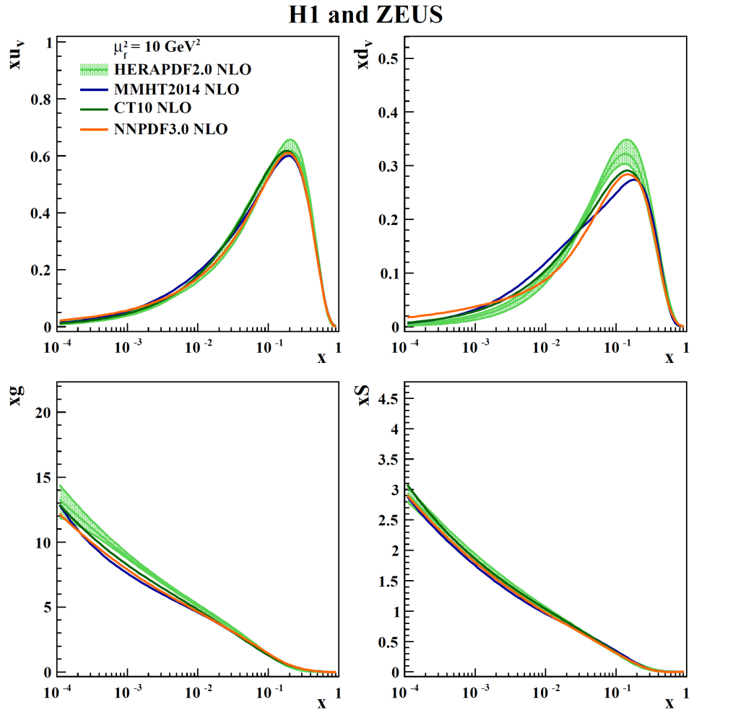
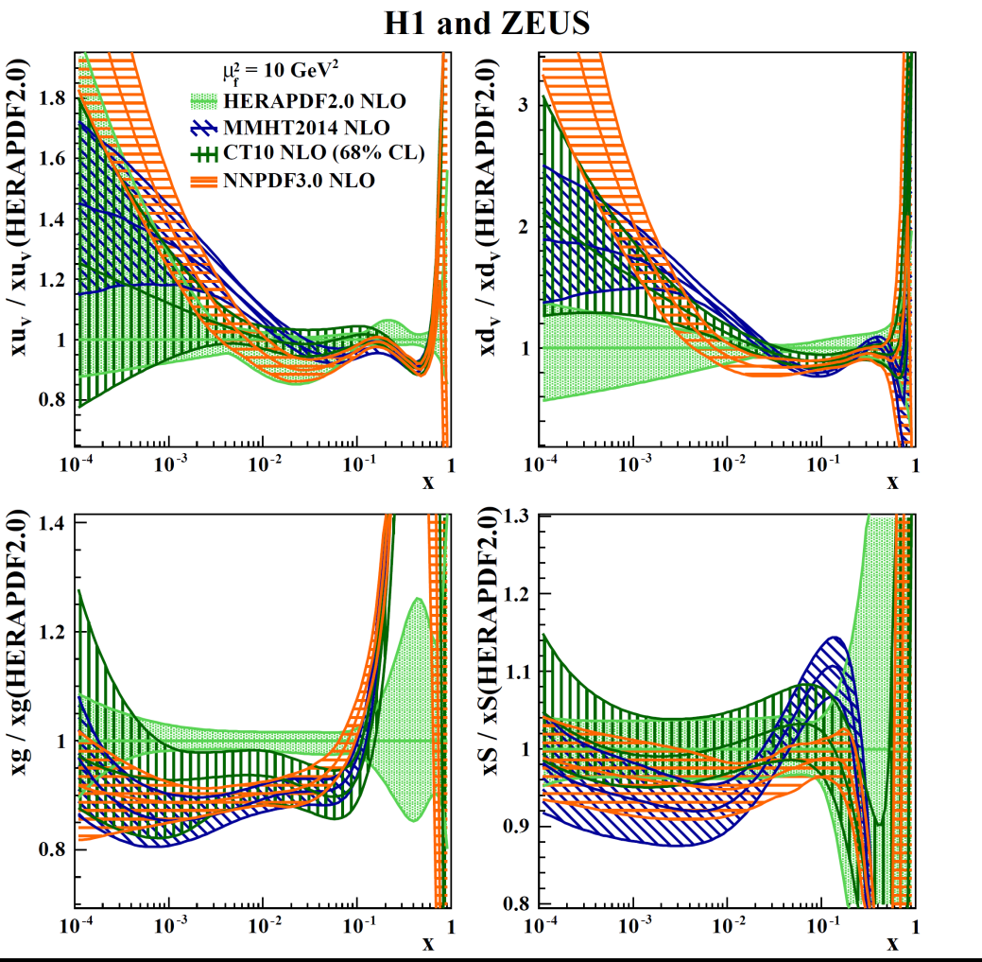
Compare HERAPDF2.0 to other PDFs at NLO
High-x valence shapes somewhat different– new high- x data and use of proton target only
Other PDFs have harder high-x gluon, but Sea is more compatible

Slide 24
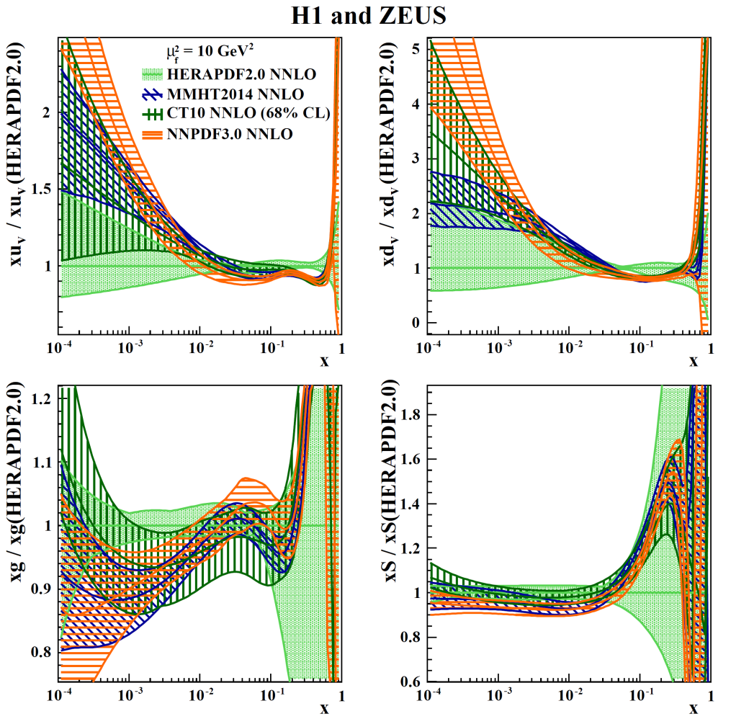
Compare HERAPDF2.0 to other PDFs at NNLO
High-x valence shapes somewhat different – new high- x data and use of proton target only
At NNLO gluon and Sea are both compatible with other PDFs

Slide 25
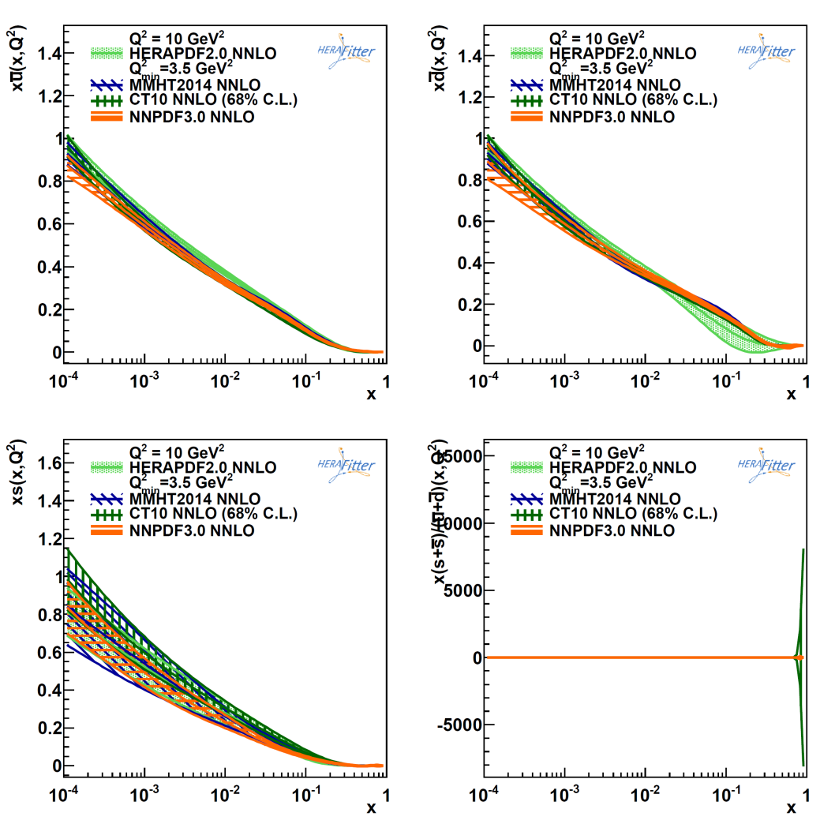
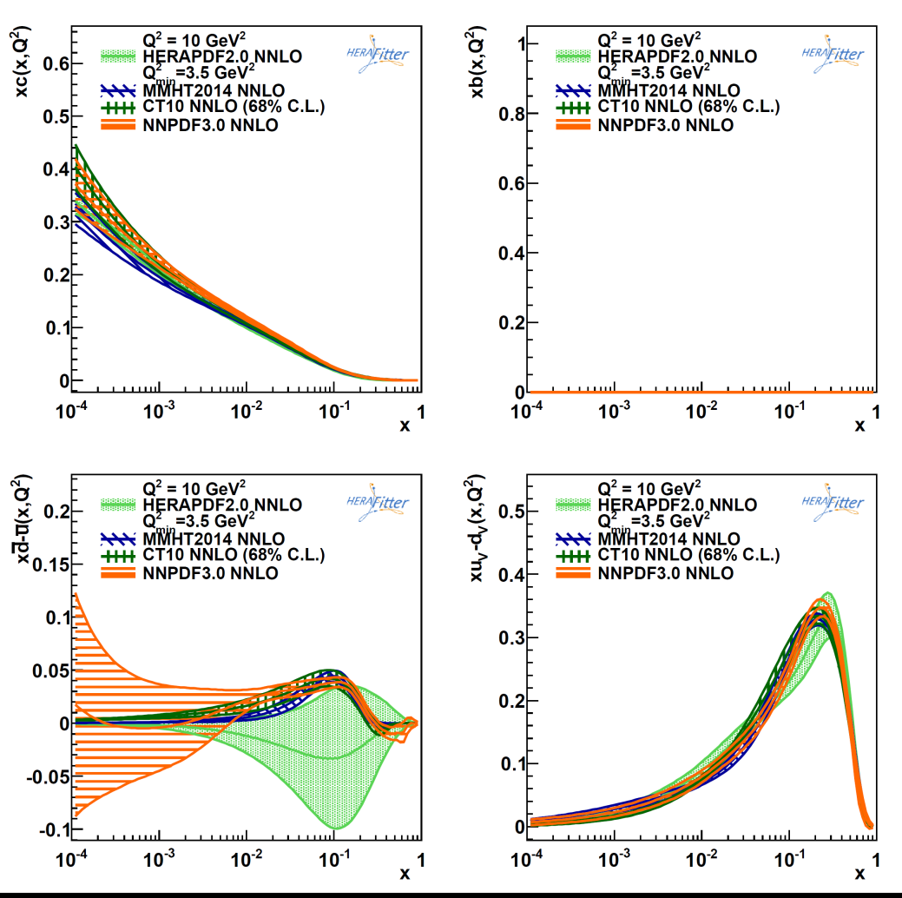
u__{valence} – d_{valence}
dominates the W-aymmmetry at Tevatron and LHC
And here are more details on the flavour break up of the Sea
In particular
dbar-ubar is negative but with large uncertainties, which cover other PDFs

Slide 26
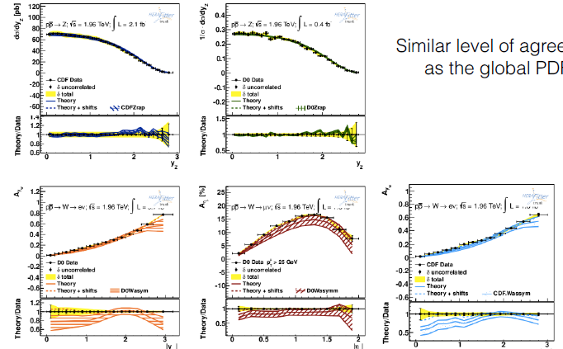


Compare HERAPDF2.0 to Tevatron and CMS W,Z data
Similar level of agreement as the global PDFs
And ATLAS top data

Slide 27


Compare HERAPDF2.0HiQ2, with Q2>10GeV² , to the standard fit at NLO
The purpose of this is to check for bias introduced by using low Q², low-x data in the fit.
Fits are compatible. At large x all PDFs are similar for 2.0 and 2.0HiQ2 thus
there is no bias at high scale due to the inclusion of the lower Q², lower x data
This is also true at NNLO.
There is greater uncertainty at low-x for Sea and glue there is some small change of gluon and sea shape at low-x.

Slide 28


Compare HERAPDF2.0 with Q2>10GeV² to the standard fit at NNLO
Fits are VERY compatible at high-x ---like in NLO case
BUT the difference in shape for low-x Sea and gluon– has now become pronounced- fits are no longer compatible
There is still no bias from including the lower Q², lower x data in the fits if we move to LHC scales
---for the ATLAS,CMS kinematic regimes.
However at very low-x and moderate Q² --as in LHCb --the NNLOfit for Q²_{min}=10 cannot be used---
the gluon becomes negative and so does the longitudinal cross section

Slide 29

Compare HERAPDF2.0 with Q2>10GeV² to the standard fit at NNLO
Fits are VERY compatible at high-x ---like in NLO case
BUT the difference in shape for low-x Sea and gluon– has now become pronounced.
At very low-x and moderate Q² --as in LHCb --the NNLOfit for Q²_{min}=10 gives a negative gluon and a negative longitudinal cross section, and thus is not fit for purpose.
Can use the HERAPDF2.0HiQ2AG– alternative gluon shape—xg(x) = A_{g} x^{Bg} (1-x)^{Cg} (1+D_{g}x), which cannot be negative at any x for Q² > Q²₀, but fit χ2 is larger by Δχ2~+30
Does this indicate a breakdown of DGLAP at low x?

Slide 30



Low Q², low-x
NLO
Q²>3.5 GeV²
Reminds us of this? arXiv:0910.3143.
The fit evolves faster than the data– so going to higher order NNLO does not improve this
NLO
Q²>10 GeV²
These are the comparisons of the fit to the NC e+p data at low Q²
The fit with Q²>10 misses the lower Q² data in a systematic matter undershooting the data – worse at low-x and low Q²---and not describing the high-y turn over

Slide 31


Comparison of HERAPDF2.0Jets to HERAPDF2.0
The fits with and without jet data and charm data are very compatible
The charm and jet data are very well fitted at NLO
There is only marginal further decrease in uncertainty due to these data when α_{S}(M_{Z}) is fixed

